Slide 1
Making Public Policy

Slide 2
What is Public Policy?
A government plan of action to solve a problem that people share collectively or that they cannot solve on their own
Might include the needs of the collective good
Keep us safe from harm
Sometimes government can address problems directly
Build a new highway
Use public policy to encourage “good” behavior or discourage “bad” behavior

Slide 3
Difficulties in Solving Public Problems
People have different ideas as to what constitutes a problem
Resolving public problems costs money
New policies can generate new problems
Public problems are often complex

Slide 4
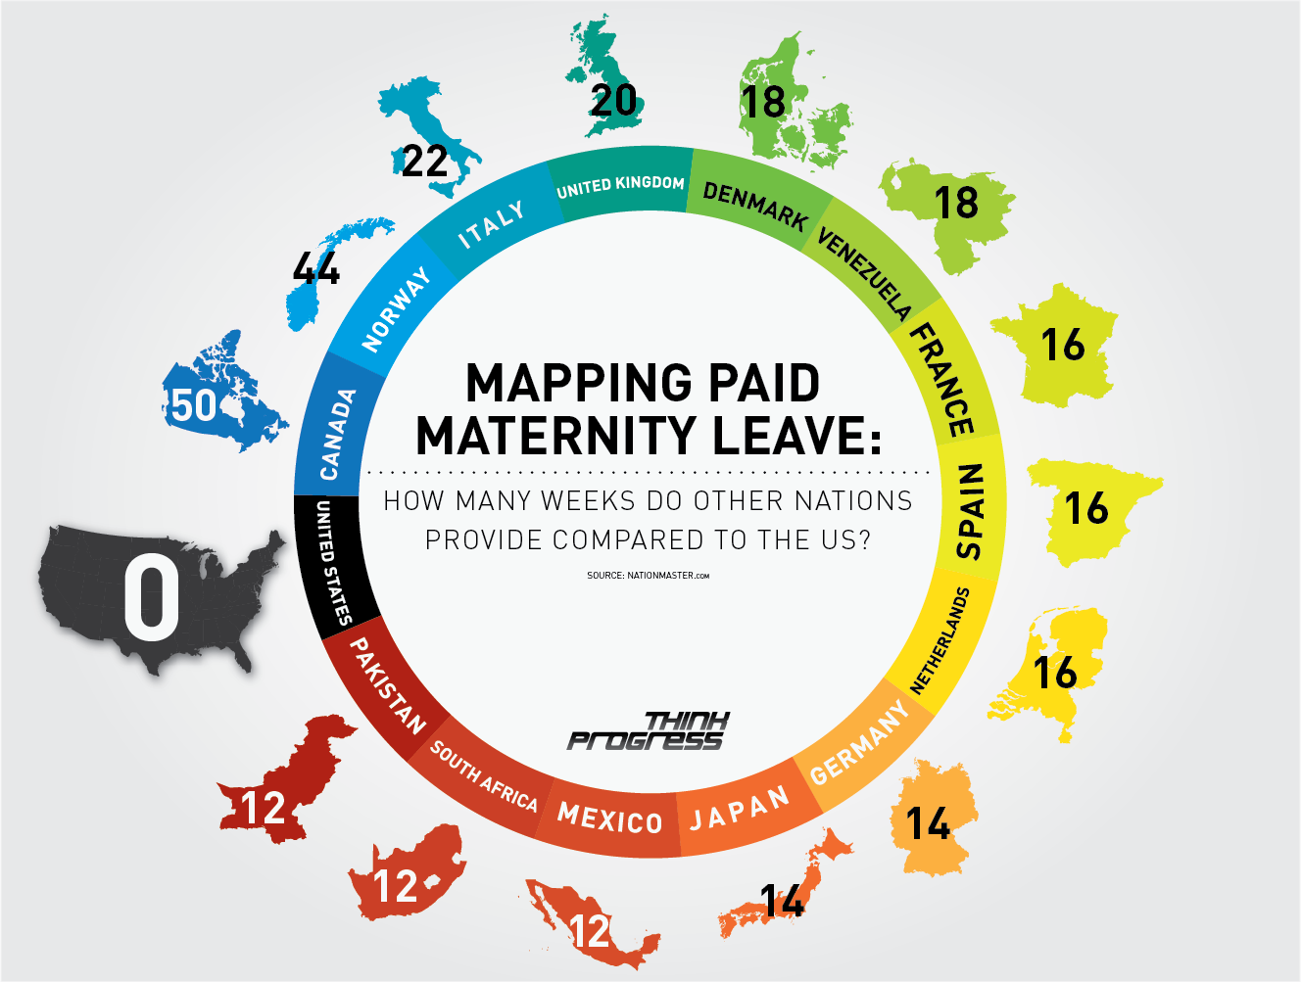
Difficulties In Solving Public Problems
What are some of the difficulties facing a national Paid Family Leave Act?

Slide 5
Types of Public Policy: Redistributive policies
Attempts to shift wealth, income and other resources from the “haves” to the “have-nots”
Examples
Income tax
Medicaid
Food Assistance
Our progressive tax income system means that more you earn the more you pay in taxes

Slide 6
Types of Policy: Distributive Policies
Policies funded by the whole taxpayer base that address the needs of particular groups
Examples
Deducting the interest one pays on their mortgage from their income taxes
FAFSA
Disaster relief
Nearly every student is eligible for some form of financial. Students who may not be eligible for need-based aid may still be eligible for Stafford Loans regardless of income or circumstance

Slide 7
Types of Policy: Regulatory
Policies designed to restrict or change the behavior of certain groups or individuals
Environmental policy
Americans’ with Disabilities Act

Slide 8
Who Makes Policy?
Congress
President
Bureaucracy
Courts

Slide 9
Steps of the Policymaking Process: Agenda Setting
Almost no policy is made unless and until a need is recognized
Triggering event
Example: Megan’s Law (1996)
Megan Kanka

Slide 10
Steps of the Policymaking Process: Policy Formulation
If enough people agree that the government needs to act, than a plan of action is formulated. At this stage, generally several alternative plans from various groups are formed
Megan’s Law
First passed in NJ in 1995 and later passed by Congress in 1996
Goal→ Keep communities safe and give families a sense of security
Policy → required sex offender registration with a database tracked by the state and available to the public

Slide 11
Steps of the Policymaking Process: Policy Adoption
Policy becomes an official action by the government .
Can take the form of legislation, executive or bureaucratic order, or court decision
No one in the House of Representatives voted against Megan’s Law

Slide 12
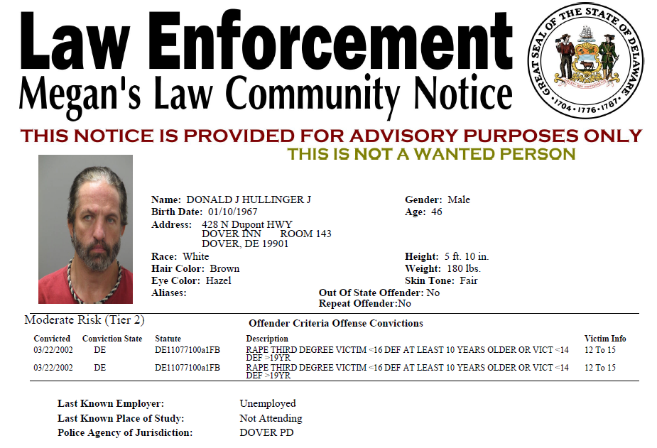
Steps of the Policymaking Process: Policy Implementation
Federal and/or state agencies interpret the policy by writing regulations, creating guidance documents or grants-in-aid
Megan’s Law
Up to the states to put together their databases and decide how to notify people

Slide 13
Steps of the Policymaking Process: Policy Evaluation
Government needs to analyze what is working and what needs to change
Fundamental questions
Does the policy as currently constructed address the initial policy problem?
Does it represent a reasonable use of public resources?
Would other strategies be more effective?
Has it produced any undesirable effects?
What is the cost-benefit analysis?
Who conducts the policy analysis?
Inside the Gov. → Government Accountability Office, Congressional Budget Office, Office of Management and Budget, Congressional Research Office
Outside the Gov. → Gates Foundation, Brookings Institution, Common Cause, Heritage Foundation, Cato Instituted, etc.

Slide 14
Evaluating Megan’s Law
Enjoys widespread community support. Supporters say it is a vital tool for protecting children
BUT
May not impact rates of sexual recidivism significantly
Could result in vigilante violence
Defined sex offender broadly
Is it fair to continue to punish those who have already served their time
Collateral effect on the family members of registered sex offenders?
No national registry

Slide 15
Changes Made to the Law
CA (1997) revised their law to remove gay men who had been prosecuted under a now-defunct anti-gay laws
Adam Walsh Child Protection Act (2006)
Sorts sex offenders into tiers
Created a national registry
Screenshot of the national registry of sex offenders

