Slide 1
AP US Government
Exam Review Materials

Slide 2
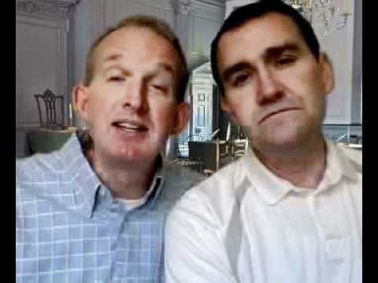
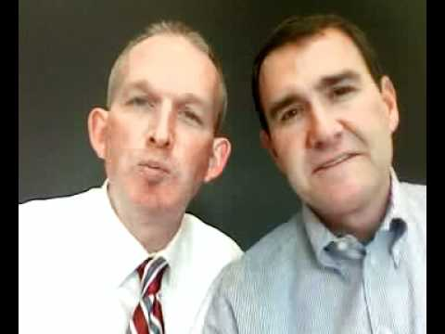
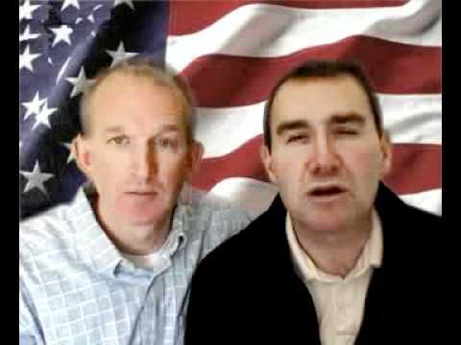
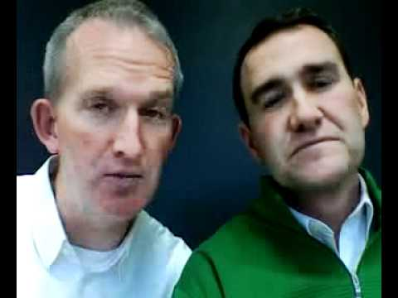
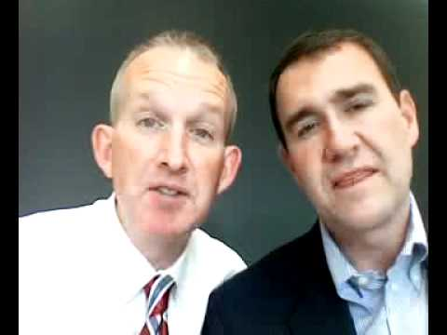
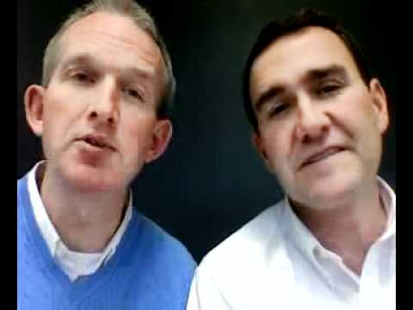
Congress Courts Political Parties
Federalism Executive Branch Foundations
Notes:
Cram for the Exam
Congress:
Terms: Article I; legislative branch; bicameral; cup and saucer; 17th amendment; filibuster; the law making process; House Rules Committee; open rule and closed rule; standing committees; Speaker of the House; Majority Leader; gerrymandering; reapportionment; incumbent and challenger; constituent service; oversight and investigation of bureaucracy
Ideas: Originally house only part of government that was directly elected by the people, not the president of the Senate. The 17th amendment changed that for the people; Founding fathers assumed House would be filled with passion reflecting debates of people on streets in 1700’s. The Senate was to temper that hot passion. Senate therefore is viewed as the more deliberative chamber of the Congress; need at least 60 votes to kill a filibuster; the House, because it is so large, strict rules are needed to keep order, especially for debate; Open and closed rules can either kill a bill or make it successful; Senate debates bills under open rules (no limit to debate); closed rule in House means you can’t add amendments to bill; Thousands of bills are introduced annually, very few become law; most bills don’t even make it out of committee; hence the power of the committee is notices; standing committees are made up of experts. The quarterback of the team in the House is the Speaker and the quarterback of the team in the Senate is the majority leader; leaders (quarterbacks) are selected on basis of seniority system and membership in majority party; district lines redrawn every ten years; every district must have same number of people; reapportionment means every ten years redrawing district lines to make sure that every district has the same number of people; state legislatures are the ones to redraw the district lines; if the lines are drawn to favor one party over another that is called gerrymandering; an incumbent is the one in office and the challenger is the one who wants the incumbents job; incumbents have a huge advantage over challengers, especially in the house; 90% of the time or more; members of congress don’t just make laws, they also engage in constituent service and overseeing and investigating the bureaucracy; this oversight and investigative role is often discounted, but it’s a huge part of the job. The big takeaway: lawmakers (members of Congress) don’t just make laws.
Courts:
Terms: Supreme Court, national laws, national court, appellate court, political ideology, judicial review, Marbury v. Madison, interstate commerce clause, Necessary and proper clause, judicial restraint, judicial activism, stare decisis, writ of certiorari
Ideas: National Court interprets laws. The appointment process for a justice is a very political one. There are 9 justices, with each justice appointed by the president and approved by the US Senate. A judge’s interpretation of the law is extremely important in deciding a case. Judges tend to look at 2 things: the intent of a law and old court cases, or in other words, they use stare decisis. Judges can interpret a law using either judicial restraint of judicial activism. Judicial activism is used by both liberal and conservative justices, so there is not one side that tends to use it more than the other. Presidents like to appoint younger justices, as it gives them a chance to extend their legacies beyond their term in office.
Political Parties:
Terms: Political Party, liberal, conservative, Republican ,Democrat, linkage institution, elections, caucus, convention, voter turnout, third party, independent, plurality, winner-take-all
Ideas: Political parties are not mentioned in the Constitution, as everyone originally believed that they were not good to have around. Political parties are linkage institutions, as they connect normal American people to the government. The primary functions of political parties are to nominate candidates, educate voters, and link ordinary citizens with the government. Political parties strive to get their nominees to win elections. As of the past few years, the two main parties, the Republican and Democrat parties, have been getting weaker, as more and more people are starting to associate themselves as independents. Although third parties never actually win the elections, they still play an important role in our government, as they bring up critical issues in our society that would not be as strongly addressed.
Federalism:
Terms: Federalism, government, central government, state government, local government, reserve powers, 10th Amendment, marble cake federalism, commerce clause, grants, mandates, categorical grants, block Grants
Ideas: The 10th amendment allowed states to have reserve powers. According to the 10th amendment, if there are any powers that the government does not possess, then they belong to the states. This statement is extremely vague. Federalism was created to protect our individual liberties. The benefits of federalism are that it encourages and proposes innovative ways to cooperate, and it encourages political activity and participation. Today, the national government has grown substantially, and has given way to the commerce clause.
Executive Branch:
Terms: The President, Articles of Confederation, Constitution, Formal and informal powers of the president, Congress, federal government, bureaucracy, War Powers Resolution, Executive Order, Executive Agreement, Checks and Balances, Executive privilege, Electoral College, Winner-Take-All
Ideas: The President is extremely powerful and important in the government. The president was left out in the Articles of Confederation, but is very important in the US Constitution. President shares many powers, mostly with Congress. The president gets more powerful as the bureaucracy gets bigger, which it has. The president can act as the Commander-in-Chief of the army, but the War Powers Resolution keeps the president’s power during war under control. With checks and balances, the House can impeach the president if it feels he has done something wrong, and the Senate can convict the president in trial. Executive privilege allows the president to be somewhat secretive while in office. The White House Staff do not have to be confirmed by the Senate, and they are usually not known by the public. They hold a lot of power, as they are the people who work directly with the president himself. These people are the president’s most trusted workers. In order for one to become president, he or she must get at least 270 electoral votes by electors in the Electoral College.
Foundations:
Terms: Articles of Confederation, Popular Sovereignty, Separation of Powers, Checks and Balances, Federalism, Bill of Rights, Free Speech Clause, Civil Rights, Civil Liberties, Selective Incorporation, 14th Amendment (Due Process Clause, Equal Protection Clause), 2nd Amendment, Brown v. Board of Education, 4th Amendment, 5th Amendment, Constitution
Ideas: The power of the government originally existed in the Articles of Confederation. The Articles were too weak to continue their usage. The Separation of Powers and Checks and balances were created in order to prevent tyranny while having a strong central government. The founding fathers chose to create Republican form of government, as they did not like the idea of the people having too much power. The 14th Amendment consists of the due process clause, and the equal protection clause. There have been 27 Amendments so far. In order for an amendment to pass, one must first propose an amendment. After that, there needs to be ⅔ support from each chamber of Congress. Lastly, ¾ of the states need to ratify the amendment in order for it to pass.

Slide 3
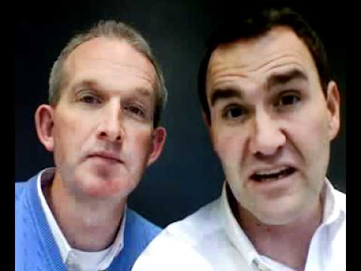
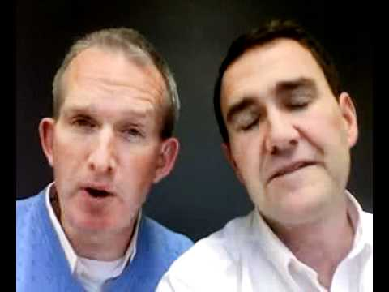
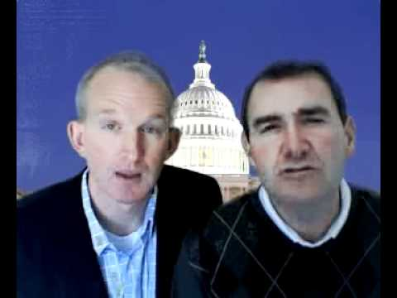
Participation
Public Opinion Interest Groups Campaigns and Elections
Notes:
Cram for the Exam
Participation:
Terms: Elections, Voter, Social Connectedness, Voter Turnout, Institutional Obstacles, Absentee voter, Liberals and Conservatives, Voting Rights Act of 1965, Motor Voter Bill of 1993, Suffrage, 15th Amendment, 19th Amendment, 26th Amendment, Political Participation
Ideas: People need to be able to vote in order for elections to be important. There are “do not” voters and “cannot” voters. The “do not” voters are people who can vote legally, but choose not to do so. The “cannot” voters are people who are ineligible to vote. The older and more educated a person is, the more likely they are to vote. In an election, a 50-55% voter turnout is considered high in America. There are institutional obstacles that may prevent people from voting, such as not being a resident of the state they are currently living in, not being a citizen of the United States, or being a convicted felon. States are aware of this, and some have been implementing programs in order to increase voter turnout. Liberals tend to want to make voting easier, while conservatives tend to want to make voting more fair and honest. The Voting Rights Act of 1965 expanded voting to the African American community. The Motor Voter Bill of 1993 allowed people to register to vote at the DMV. The 26th Amendment allowed 18 year olds to vote. This decreased voter turnout tremendously, as younger people are very unlikely to vote.
Public Opinion:
Terms: Public Opinion, Popular Sovereignty, Political Socialization, Liberals and Conservatives, Democrats and Republicans, Moderates, Political Ideology, Economic Policy, Social Policy, Public Opinion Poll, Public Opinion, Pluralist, Elite, Political Efficacy
Ideas: There are many factors that can sway a person politically (To the left or the right), such as age, gender, race, and occupation. The typical Democrat lives in northern cities and is either African American or Latino. The typical Republican tends to be more educated, middle to upper class, protestant, caucasian, older, and lives in the suburbs or rural areas. Political ideology is a set of beliefs about what individuals think that the government should do. Liberals believe in expanded role of government in economic policy, while in social policy liberals believe in less government intervention. Conservatives believe in less government role in economic policy, and moron social policy. As more and more Americans are seeing themselves as moderates, the 2 main political parties are growing weaker and weaker. Election outcomes and public opinion polls are ways that we can see what American voters are thinking.
Interest Groups:
Terms: Political Parties, Linkage Institutions, Public Policy, Interest Groups, Corporation, PACs, NAACP
Ideas: Fundamental role of interest groups is to win an issue when creating public policy. Interest groups try to spread information to powerful people, in order to persuade public policy. Interest groups can change policy fast if they get access to the powerful people. PACs, or Political Action Committees, give money to candidates that are running in an election. The NAACP used litigation to grant greater rights for African Americans.
Campaigns and Elections
Terms: Linkage Institution, Campaigns, Elections, Primary Election, General Election, Caucus, Primary, Front-loading, 4 M’s (Mentioned, Momentum, Money, “Mo Money”), Campaign Finance Laws, Soft Money, Fat Cats, Independent Expenditures, Supreme Court, Incumbents, Constituent Service
Ideas: Campaigns and elections are linkage institutions because they connect ordinary people to the government. Representatives in the House run in the election every 2 years, nominees for the presidential election every 4 years,and nominees to become US Senator run every 6 years. In order for someone to win an election, a person must first be nominated by their party. They then must beat the other person they are running against. In a way, a nominee has to win twice to win the entire election. One must develop a personal following in order to become popular and have a successful campaign. Front-loading refers to the early caucuses and primaries. Campaign Finance Laws restricts the amount of money one can receive during a campaign. Independent Expenditures have no limits and no disclosure when it comes to supplying money. The only problem is that they cannot coordinate with the candidate themselves. During presidential election campaigning, candidates try to win over the extreme voters (their base) during the primaries, but during the general election, have to go back to appealing to the moderate voters.

Slide 4
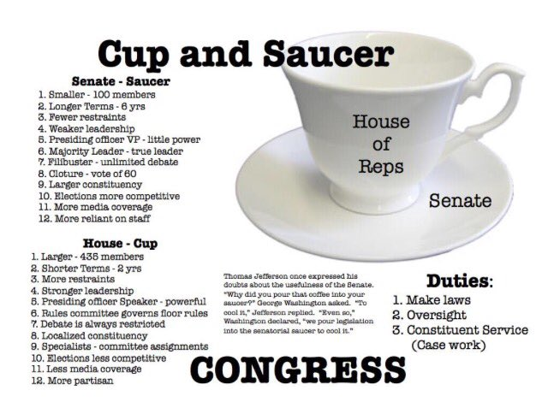

Slide 5
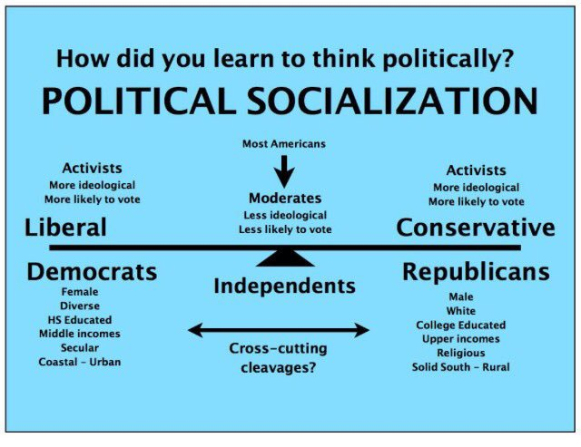

Slide 8
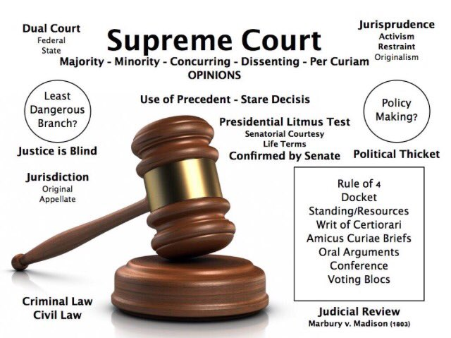

Slide 9
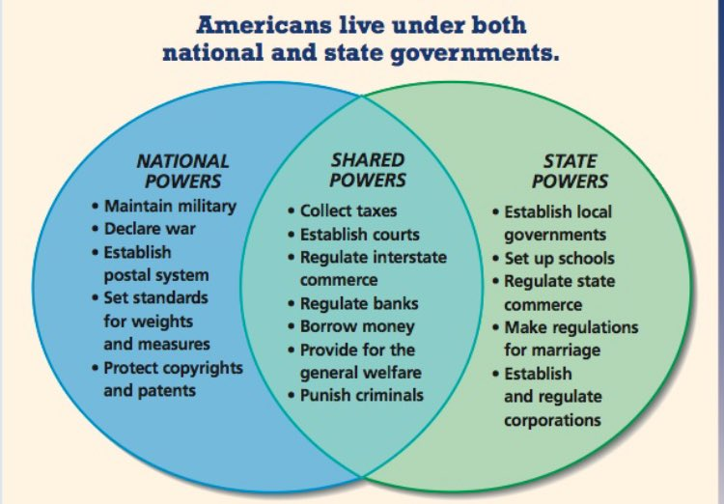

Slide 10
Latin Phrases
Amicus Curiae Brief
Writ of Certiorari
Writ of Habeas Corpus
Stare Decisis
In Forma Pauperis
Amendments
10th Amendment
14th Amendment
15th Amendment
16th Amendment
17th Amendment
19th Amendment
22th Amendment
25th Amendment
26th Amendment
Precedent Setting USSC Cases
Marbury v. Madison
Dred Scott v. Sandford
McCulloch v. Maryland
Plessy v. Ferguson
Brown v. Board of Education
Gitlow v. New York
Mapp v. Ohio
Gideon v. Wainwright
Miranda v. Arizona
Roe v. Wade
Committees
Standing Committee
Select Committee
Joint Committee
Conference Committee
Notes:
Latin Phrases
Amicus Curiae Brief: A brief submitted by an attorney who does not represent either side in the case but is to be considered a “friend of the court.” In other words, one who wants to express his/or opinion on the question the the justices have to decide
Writ of Certiorari: An order by a higher court directing a lower court to send up a case for review
Writ of Habeas Corpus: An order by a higher court to produce an arrested person before a judge
Stare Decisis: “Let the decision stand,” or allowing prior rulings to control the current case
In Forma Pauperis: A method whereby a poor person can have his or her case heard in federal court without being charge a fee
Ex Post Facto Law: An ex post facto law is a law which makes a particular act illegal, and punishes people who committed that crime before the law was passed (when the act was legal)
Amendments
10th Amendment: States that the powers that are not expressly given to the federal government by the Constitution are reserved to the states or the people. Also known as "reserved powers amendment" or "states' rights amendment". An after thought. Has rarely had much practical significance From time to time the USSC has tried to interpret this amendment to put certain state activities beyond the reach of the federal government but invariably the USSC has later changed its mind and allowed (Washington) the federal government to regulate such matters as. . . the hours that employees of a city owned mass transit system may work. The court did not find that running such a transportation system was one of the powers reserved to the states. Today, however, the court is beginning to give new life to the 10th. How far this will go . . . is to be seen.
14th Amendment: States that (1) All persons born in the U.S. are citizens; (2) no person can be deprived of life, liberty or property without due process of law;; (3) no state can deprive a person of equal protection of the laws
15th Amendment: States that states cannot deny any person the right to vote because of race, color, or previous condition of servitude
16th Amendment: States that Congress has the power to tax income
17th Amendment: Established the direct election of senators (instead of being chosen by state legislatures)
19th Amendment: States that citizens cannot be denied the right to vote because of gender
22nd Amendment: States that the president is limited to two terms
25th Amendment: States that the Vice President shall become president in the event of death, resignation, removal from office or impairment that prevents the current president from fulfilling his or her duties
26th Amendment: States that the right to vote shall not be denied based on age (18+ years of age)
Precedent Setting USSC Cases
Dred Scott v. Sandford: Ruled that escaped slaves not free but property
Marbury v. Madison: Established courts power of judicial review
Mcculloch v. Maryland: Set precedent for broad interpretation of N&P clause; thereby increasing power of Congress and the Federal government. Whether Congress had the power to set up a bank in Maryland? Whether a federal bank can be lawfully taxed by a state. The USSC having answered the first question with a YES and the second question with a NO, thus declared unconstitutional the Maryland law that sought to tax the national bank. Hence the bank was allowed to exist. The more broadly the USSC interprets the necessary and properly clause, the more power goes to the federal government (over the states) and to the Congress (over the other branches of government.
Plessy v. Ferguson: Established separate but equal doctrine
Brown v. Board of Education: Overturned Plessy and ordered “integration of public schools with all deliberate speed.”
Gitlow v. New York: Established precedent of federalizing Bill of Rights (applying them to States); States cannot deny freedom of speech: protected through due process clause of Amendment 14. Thus said that the bill of Rights are incorporated into the 14th Amendment
Mapp v. Ohio: Established exclusionary rule
Gideon v. Wainwright: Established public defender's’ office
Miranda v. Arizona: ruled that accused must have his Miranda right read prior to interrogation
Roe v. Wade: ruled that women have a right to privacy and there an unfettered right to an abortion through second trimester
Committees
Standing Committees: Permanently established legislative committees that consider and are responsible for legislation within a certain subject area
Select Committees: Congressional committees appointed for a limited time and purpose
Joint Committees: Committees on which both senators and representatives serve
Conference Committee: Joint committees appointed to resolve differences in the Senate and House versions of the same bill

Slide 11
Famous Congressional Acts
War Powers Act
Motor Voter Act
Pendleton Act
Civil Rights Act of 1965
Voting Rights Act 1965
Patriot Act
Social Security Act of 1936
Clean Air Act 1970
Clean Air Act of 1990
Congressional Budget and Impoundment Act of 1974
Gramm Rudman Act
Endangered Species Act
Freedom of Information Act
Whistleblower Protection Act
Institutions
Linkage Institutions
Federal Institutions of Government
Linkage Institutions
Political Parties
Interest Groups
Campaigns and Elections
Media
Federal Institutions of Government
Congress
Presidency
Judiciary
Bureaucracy
Notes:
Famous Congressional Acts
War Powers Act: President could send troops overseas to an area where hostilities were imminent only if: 1. He notified Congressional leaders within 48 hours; 2. He withdrew troops within 60-90 days. 3. He consulted with Congress if troops were to engage in combat. Congress can pass resolution to have troops withdrawn at any time.
Motor Voter Act: Requires states to allow people to register to vote when applying for driver's licenses or completing license renewal forms.
Pendleton Act: Federal legislation which created a system in which federal employees were chosen on the basis of competitive examinations, therefore making merit, or ability, the reason for hiring people to fill federal positions. This ended the use of the spoils system.
Civil Rights Act of 1965: Bans discrimination in public places on basis of race, color, national origin or religion 1. prohibits employment discrimination on basis of gender and race, color, national origin or religion 2. allows employers to give racial preferences in hiring; 3. Executive Order #1246 required federal contractors to adopt affirmative action programs; 4. allowed class action suits;
Voting Rights Act of 1965: invalidated the use of any test (like a literacy test) or device to deny the vote and authorized federal examiners to register voters in states that had disenfranchised blacks; as more blacks became politically active and elected black representatives, it brought jobs, contracts, and facilities and services for the black community, encouraging greater social equality and decreasing the wealth and education gap.
Patriot Act: This act increased the ability of law enforcement agencies to search telephone, e-mail, medical, financial, and other records, eased restrictions on foreign intelligence gathering within the United States, expanded the Secretary of the Treasury's authority to regulate financial transactions, and enhanced the discretion of law enforcement and immigration authorities in detaining and deporting immigrants suspected of terrorism-related acts.
Social Security Act of 1936: passed to provide a minimal level of sustenance to older Americans.
Clean Air Act of 1970: Required EPA to develop and enforce regulations to protect the public from airborne contaminants; forced states to follow and make sure the laws for followed in relation to the EPA. States allowed to decide officials for enforcement.
Clean Air Act of 1990: Increased the Strictness of Air Pollution Regulations. Set a National limits of air toxin levels, requiring states to raise pollution controls to meet standards. Requires states to use pollution controls no weaker than the federal government's.
Congressional Budget and Impoundment Act of 1974: an act designed to reform the budgeting process by making Congress less dependent on the president's budget; established a fixed budget calendar and a budget committee in each house.
Gramm Rudman Act: 1. Set gradual reduction targets to lead a balanced budget. 2. Across-the-board budget cuts (sequestering of funds) to kick in if targets are not met. 3. Loopholes: abandonment in the late 80s.
Endangered Species Act: provides for the conservation of species that are endangered or threatened throughout all or a significant portion of their range, and the conservation of the ecosystems on which they depend
Freedom of Information Act: A law passed in 1966 that requires federal executive branch and regulatory agencies to make all information available to journalists, scholars, and the public, unless it falls into one of several confidential categories.
Whistleblower Protection Act: A law that protects federal whistleblowers who work for the government and report agency misconduct. A federal agency violates the Whistleblower Protection Act if agency authorities take (or threaten to take) retaliatory personnel action against any employee or applicant because of disclosure of information . . . whether it be information describing gross mismanagement; gross waste of funds; an abuse of authority; or a substantial and specific danger to public health or safety.
Institutions
Linkage Institutions: A structure within a society that connects the people to the government and the government to the people
Federal Institutions of Government: The Congress, Presidency, Judiciary and Bureaucracy
Linkage Institutions
Political Parties: An organization of people that seeks to elect candidates to public office.
Interest Group: An organization of people sharing a common interest or goal and that seeks to influence public policy.
Campaigns and Elections:
Media:
Federal Institutions of Government
Congress:
Presidency:
Judiciary:
Bureaucracy: A large, complex organization composed of appointed officials.

Slide 12
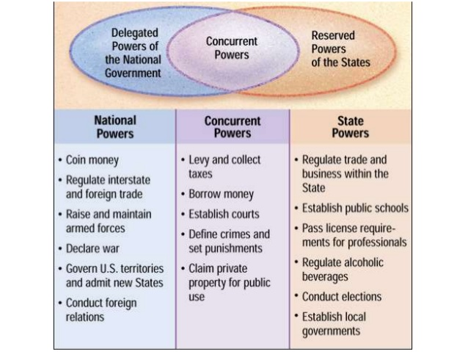
Federalism
commerce
Eminent domain
Serve as Commander in Chief

Slide 13
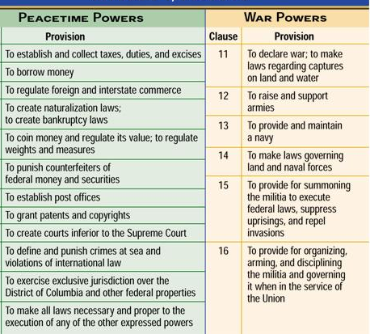

Slide 14
The House | The Senate
435 members | 100 members
Represents area called a district | Represents area called a state
Two year term | Six year term
Lower House | Upper House
Entire chamber up for reelection every two years | ⅓ of chamber up for reelection every 6 years
Qualifications 25 years old Citizen of US for 7 years Inhabitant of state from which elected | Qualifications 30 years old Citizen of US for 9 years Inhabitant of state from which elected
Smaller constituencies | Larger constituencies
Less prestige | More prestige

Slide 15
Lower visibility in news media | Higher visibility in news media
Debate that is typically limited | Debate that is typically unlimited (filibuster)
Most work done in committees and less on floor | Work is split evenly between committees and the floor
Has a speaker of the House | Has a President Pro Tempore
All revenue (tax and spending bills) must originate here | Approves or rejects treaties, presidential appointments
Has the power to impeach | Has the power to hold a trial following impeachment
More likely to get reelected | Slightly less likely to get re elected
Mostly only receive local attention | Receive state, national, and sometimes even international attention
Cup | Saucer

Slide 16
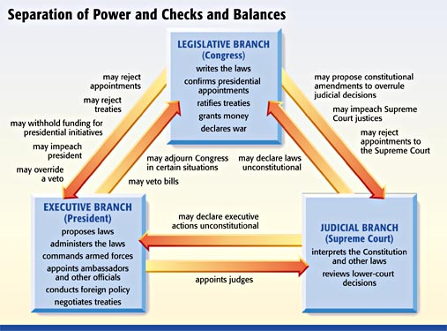

Slide 17
Judicial Review:
The power of the courts to declare unconstitutional acts of the legislature and orders of the President
Notes:
Not explicitly stated in Constitution
Power given to court by the USSC in case of Marbury v. Madison
One of only a few countries on the planet entrusting their courts with this power
Gives court the power to check both the executive and legislative branch, thus also the bureaucracy.
Given that the judges are appointed rather than elected, it can be argued that the courts are an undemocratic institution.
A great example of the court using its power of judicial review is the case of Roe v. Wade: the case in which the court ruled that women have a right to privacy and there an unfettered right to an abortion through the second trimester.

Slide 18
Who has the power to
Impeach
Levy and collect taxes
Declare war
Provide and maintain a navy
Create courts inferior to the US Supreme Court
Increase/decrease the number of USSC justices
Establish public schools
Make all laws necessary and proper for carrying out the express powers of Congress
Declare laws of the legislature unconstitutional
Regulate intrastate trade
Regulate interstate trade
Appoint ambassadors
Enter into a treaty with a foreign nation
Ratify a treaty
Confirm a USSC appointee
Set punishment for crimes
Senate
House
Congress (both House and Senate
President
USSC
The states
Both the federal and state gov
Notes:
House: Impeach
Both the Feds and State Gov: Levy and collect taxes
Congress: Declare war
Congress: Provide and maintain a navy
Congress: Create courts inferior to the US Supreme Court
Congress: Increase/decrease the number of USSC justices
States: Establish public schools
Congress: Make all laws necessary and proper for carrying out the express powers of Congress
Supreme Court: Declare laws of the legislature unconstitutional
States: Regulate intrastate trade
Congress: Regulate interstate trade
President: Appoint ambassadors
President: Enter into a treaty with a foreign nation
Senate: Ratify a treaty
Senate: Confirm a USSC appointee
Both the Feds and State Gov: Set punishment for crimes

Slide 21
With the word Political
Political Power
Political Elite
Political Culture
Political Ideology
Political Cleavage
Political Socialization
Political Agenda
Political Party
Political Machine
Political Action Committee
Examples of Direct Democracy
Recall
Referendum
Initiative
Jury System
Process
The Presidential Selection Process
The Impeachment Process
The Amendment Process
The Bill Making Process
The Nomination and Confirmation Process
The Treaty Making Process
Why Incumbents Usually Win
Constituent Service
Name Recognition
Sophomore Surge
War Chest
Notes:
Words with the word Political
Political Power: The ability of one person to cause another person to act in accordance with the first person’s intentions. The ability to control another person’s behavior. May be obvious: President sends soldiers into combat. May be subtle: President’s junior speechwriters take a new tone when writing about a controversial issue. Not to be confused with Authority: The right to use power; not all who exercise political power have authority to do so. Also not to be confused with Legitimacy: What makes a law or constitution a source of right?
Political Elites: Persons with a disproportionate share of political power. (7)
Political Culture: A patterned and sustained way of thinking about how political and economic life ought to be carried out. (4)
Political Ideology: A more or less consistent set of beliefs about what policies government ought to pursue. (7)
Political Cleavage: Political cleavages are national, ethnic, linguistic, and religious divisions that affect political allegiances and policies. (Wiki)
Political Socialization: Process by which background traits influence one's political views. (7)
Political Agenda: Issues that people believe require governmental action. (17)
Political Party: A group that seeks to elect candidates to public office. (9)
Political Machine: A party organization that recruits members by dispensing patronage. (9)
Political Action Committee: A committee set up by a corporation, labor union, or interest group that raises and spends campaign money from voluntary donations. (10, 11)
Examples of Direct Democracy
Recall: Procedure whereby voters can remove an elected official from office. (3)
Referendum: Procedure enabling voters to reject a measure passed by the legislature. (3)
Initiative: Process that permits voters to put legislative measures directly on the ballot. (3)
Jury System: A jury trial or trial by jury is a legal proceeding in which a jury either makes a decision or makes findings of fact, which then direct the actions of a judge. It is distinguished from a bench trial, in which a judge or panel of judges make all decisions. A jury is a body of people (typically twelve in number) sworn to give a verdict in a legal case on the basis of evidence submitted to them in court. (Wiki)
Process
The Presidential Selection Process: The Presidential election process follows a typical cycle:
Spring of the year before an election :Candidates announce their intentions to run.
Summer of the year before an election through spring of the election year :Primary and caucus debates take place.
January to June of election year :States and parties hold primaries and caucuses.
July to early September :Parties hold national nominating conventions to choose their candidates.
September and October :Candidates participate in Presidential debates.
Early November :General Election Day
December :Electors cast their votes in the Electoral College.
Early January of the next calendar year :Congress counts the electoral votes.
January 20 :Inauguration Day
The Impeachment Process: At the federal level, the impeachment process is a two-step process.
The House of Representatives must first pass, by a simple majority of those present and voting, articles of impeachment, which constitute the formal allegation or allegations. Upon passage, the defendant has been "impeached". This requires a simple majority.
Next, the Senate tries the accused. In the case of the impeachment of a president, the Chief Justice of the United States presides over the proceedings. To convict the accused, a two-thirds majority of the senators present is required. Conviction removes the defendant from office. Conviction by the Senate does not bar criminal prosecution..
The Amendment Process: Amending the Constitution consists of proposing an amendment and subsequent ratification.
Amendments may be proposed either by the Congress with a two-thirds vote in both the House of Representatives and the Senate or by a constitutional convention called for by two-thirds of the state legislatures.
To become part of the Constitution, an amendment must be ratified by either—as determined by Congress—the legislatures of three-fourths of the states or State ratifying conventions in three-fourths of the states.
The Bill Making Process:
Introducing the Bill and Referral to a Committee: Any member of Congress can introduce legislation. The person or persons who introduce the bill are the sponsors; any member of the same body (House or Senate) can add his or her name after the day of introduction as a cosponsor. When a bill is introduced, it is given a number: H.R. signifies a House bill and S. a Senate bill. The bill is then referred to a committee with jurisdiction over the primary issue of the legislation. Sometimes, a bill will be referred to multiple committees. The bill is referred sometimes to a subcommittee first.
Committee Action: Hearings and Mark Up: The chairman of the Committee determines whether there will be a hearing on the bill and whether there will be "mark up." Usually, a subcommittee holds the hearing. Sometimes a bill is marked up both in subcommittee and then in full committee, but it can have action taken only at the full committee level. A mark up is when members of the Committee officially meet to offer amendments to make changes to the bill as introduced. After amendments are adopted or rejected, the chairman moves to vote the bill favorably out of Committee. The bill will go to the entire body if the Committee favorably reported out the bill.
Committee Report: The Committee Chairman's staff writes a report of the bill describing the intent of legislation, the legislative history such as hearings in the Committee, the impact on existing laws and programs, and the position of the majority of members of the committee. The members of the minority may file dissenting views as a group or individually. Usually, a copy of the bill as marked up is printed in the Report.
Floor Debate and Votes: The Speaker of the House and the Majority Leader of the Senate determine if and when a bill comes before the full body for debate and amendment, and final passage. There are very different rules of procedure governing debate in the House and Senate. In the House, a Representative may offer an amendment to the bill only if he has obtained "permission" from the Rules Committee. In the Senate, a Senator can offer an amendment without warning so long as the amendment is germane to the underlying bill. A majority vote is required for an amendment and for final passage. Sometimes, amendments are accepted by a "voice vote."
Referral to the Other Chamber: When the House or the Senate passes a bill it is referred to the other chamber where it usually follows the same route through committee and floor action. This chamber may approve the bill as received, reject it, ignore it, or amend it before passing it.
Conference on a bill: If only minor changes are made to a bill by the other chamber, usually the legislation goes back to the originating chamber for a concurring vote. However, when the House and Senate versions of the bill contain significant and/or numerous differences, a conference committee is officially appointed to reconcile the differences between the two different versions into a single bill. If the conferees are unable to reach agreement, the legislation dies. If agreement is reached, a conference report is prepared describing the committee members' recommendations for changes. Both the House and the Senate must approve of the conference report. If either chamber rejects the conference report, the bill dies.
Action by the President: After the conference report has been approved by both the House and Senate, the final bill is sent to the President. If the President approves of the legislation, he signs it and it becomes law. If the President does not take action for ten days while Congress is in session, the bill automatically becomes law. If the President opposes the bill he can veto it; or, if he takes no action after the Congress has adjourned its second session, it is a "pocket veto" and the legislation dies.
The Nomination and Confirmation Process:
The confirmation process begins when the President selects a nominee for a vacant judgeship. Traditionally, the President selects a nominee in consultation with the Senators who represent the state in which the judge will serve. Senators typically have their own methods of evaluating potential nominees, and can signal their approval or disapproval of a nominee through the blue slip process. For the president to consult with the Senators this way is known as Senatorial Courtesy.
The President then refers the nominee to the Senate Judiciary Committee. The Judiciary Committee evaluates the nominee by gathering information, running a background check, and reviewing the record and qualifications of the nominee.
The Judiciary Committee holds a hearing on the nominee. Witnesses present testimony on the nominee. Some of the witnesses favor and others oppose the nomination. The nominee also answers questions from the Committee. Senators who oppose a nominee can attempt to delay or derail a nomination by requesting additional information or additional time as a hearing approaches.
The Judiciary Committee votes on whether to report the nominee to the full Senate. If the Committee does report the nominee, they can submit the nomination with a favorable recommendation, an unfavorable recommendation, or no recommendation at all. Senators who oppose the nomination can attempt to delay a nomination by using procedural tactics to prevent a committee vote.
The full Senate has the opportunity to debate the nomination. The Senate debates until a Senator asks for unanimous consent to end debate and move to a vote on the nominee. If unanimous consent is granted, the Senate votes on the nominee, with a majority vote required for confirmation. Any Senator can refuse to grant unanimous consent. This situation is known as a hold.
If any Senator objects to unanimous consent, then a cloture motion must be filed in order to end debate and move to a vote. Cloture motions for judicial and executive nominations require 51 votes to pass. If 51 Senators support cloture, the full Senate will vote on the nomination, with a majority required for confirmation. If fewer than 51 Senators support cloture, debate continues and a confirmation vote cannot occur. This is known as a filibuster. Prior to the November 2013 Senate rules change, all cloture motions required 60 votes to pass. Now, only cloture motions for legislation and nominees to the Supreme Court require 60 votes.
Once the Senate holds a confirmation vote, with a simple majority voting to confirm, the nominee becomes a Federal Judge.
The Treaty Making Process:
Secretary of State authorizes negotiation.
U.S. representatives negotiate.
Agree on terms, and upon authorization of Secretary of State, sign treaty.
President submits treaty to Senate.
Senate Foreign Relations Committee considers treaty and reports to Senate.
Senate considers and approves by 2/3 majority. President proclaims entry into force.
Why Constituents Usual Win
Constituent Service: A constituent is any person living in the district of an elected official. Constituent service is when a member of Congress provides services to voters such as providing help with federal agencies, federal grants, and students who want to attend the US military academies, who live in the district the representative or senator serves.
Name Recognition: In politics, name recognition is the number of people who are aware of a politician. It is considered an important factor in elections, as candidates with low name recognition are unlikely to receive votes from people who only casually follow politics.
Sophomore Surge: An increase in the votes congressional candidates usually get when they first run for reelection.
War Chest: In politics, a war chest is funding obtained from donors well in advance of a campaign, usually accumulated by an incumbent for either re-election or to contest a more advanced office, or provided by a wealthy candidate to their own campaign

Slide 22
Jim Crow Laws
Poll Tax
Grandfather Clause
Intimidation
Literacy Test
White Primary
Standing Committees
House Rules Committee
Senate Judiciary Committee
House Ways and Means Committee
House and Senate Appropriations Committee
With the word Party
Third Party
Minor Party
Party Coalition
National Party Convention
National Party Committee Chairperson
Party Realignment
With the word Veto
Presidential veto
Pocket veto
Line Item veto
Legislative veto
Veto override
Notes:
Jim Crow Laws
Poll Tax: A requirement that citizens pay a tax in order to register to vote. (8)
Grandfather Clause: A clause in registration laws allowing people who do not meet registration requirements to vote if they or their ancestors had voted before 1867. (8)
Intimidation:
Literacy Test: A requirement that citizens show that they can read before registering to vote. (8)
White Primary: The practice of keeping blacks from voting in the southern states' primaries through arbitrary use of registration requirements and intimidation. (8)
Standing Committees
House Rules Committee: The Committee on Rules, or (more commonly) Rules Committee, is a committee of the United States House of Representatives. Rather than being responsible for a specific area of policy, as most other committees are, it is in charge of determining under what rule other bills will come to the floor.
Senate Judiciary Committee: In charge of conducting hearings prior to the Senate votes on confirmation of federal judges (including Supreme Court justices) nominated by the president.
House Ways and Means Committee: The chief tax writing committee.
House Appropriations Committee: The United States House Committee on Appropriations is responsible for passing appropriation bills along with its Senate counterpart. The bills passed by the Appropriations Committee regulate expenditures of money by the government of the United States.
With the word Party
Third Party: The term third party is used in the United States for any and all political parties in the United States other than one of the two major parties (Republican Party and Democratic Party).
Minor Party: A minor party is a political party that plays a smaller (in some cases much smaller) role than a major party in a country's politics and elections.
Party Coalition: A political alliance, also referred to as a political coalition, political bloc, is an agreement for cooperation between different political parties on common political agenda, often for purposes of contesting an election to mutually benefit by collectively clearing election thresholds, or otherwise benefiting from characteristics of the voting system or for government formation after elections.
National Party Convention: A meeting of party delegates held every four years. (9)
National Party Committee Chairperson: Day-to-day party manager elected by the national committee. (9)
Party Realignment: A party realignment in the United States is when the balance of power between a country's political parties changes greatly. Their electoral coalitions (the groups of people who vote for them) change dramatically. Sometimes, this happens when political parties die out or are created.
Party Realignment Election A party realigning election (often called a critical election or political realignment) is a term from political science and political history describing a dramatic change in the political system. Scholars frequently apply the term to American elections and occasionally to other countries. Usually it means the coming to power for several decades of a new coalition, replacing an old dominant coalition of the other party as in 1896 when the Republican Party (GOP) became dominant, or 1932 when the Democratic Party became dominant. More specifically, it refers to American national elections in which there are sharp changes in issues, party leaders, the regional and demographic bases of power of the two parties, and structure or rules of the political system (such as voter eligibility or financing), resulting in a new political power structure that lasts for decades.
With the word Veto
Presidential veto: This veto can be overridden only by a two-thirds vote in both the Senate and the House. If this occurs, the bill becomes law over the President's objections. A pocket veto occurs when Congress adjourns during the ten-day period. The President cannot return the bill to Congress.
Pocket Veto: A bill fails to become law because the president did not sign it within 10 days before Congress adjourns. (14)
Line Item Veto: An executive's ability to block a particular provision in a bill passed by the legislature.
Legislative Veto: The authority of Congress to block a presidential action after it has taken place. The Supreme Court has held that Congress does not have this power. (14, 15)
Veto override: The process by which each chamber of Congress votes on a bill vetoed by the President. To pass a bill over the president's objections requires a two-thirds vote in each Chamber. Historically, Congress has overridden fewer than ten percent of all presidential vetoes.

Slide 23
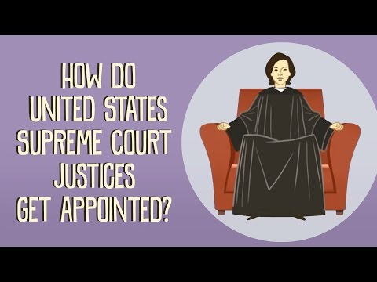
https://vimeo.com/161250066
Password
sprinkles
The Appointment Process
Ted Ed Lesson
Notes:
:

Slide 24
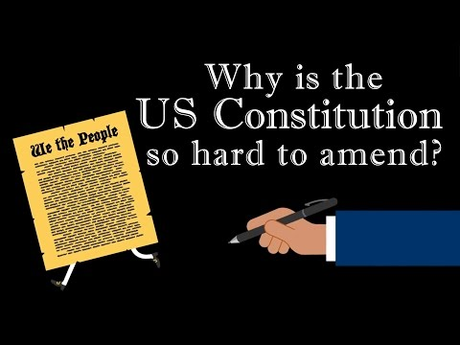
https://vimeo.com/161250066
Password
sprinkles
The Amendment Process
Ted Ed Lesson
Notes:
:

Slide 25
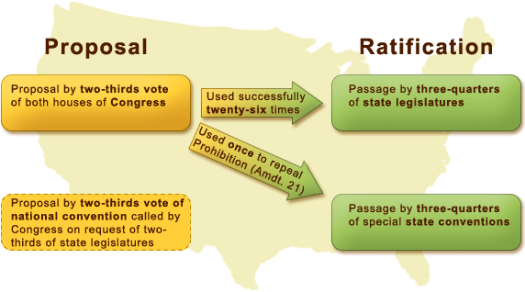

Slide 26
As described in the Constitution, there are _____ different ways to propose an amendment and _____ different ways to ratify an amendment.
Regardless of the method used, to amend the constitution requires the _____ government to propose the amendment and the _______ government to ratify the amendment.
To propose an amendment requires a _______ majority
To ratify an amendment requires a _______ majority
How many times has the Constitution been amended
Describe one major way that the constitution today is from time to time being “informally” amended
Who said the earth should belong to the living?
True/False: The amendment process is an example of federalism?
Notes:
As described in the Constitution, there are two different ways to propose an amendment and two different ways to ratify an amendment.
Regardless of the method used, to amend the constitution requires the federal government to propose the amendment and the state government to ratify the amendment.
To propose an amendment requires a 2/3rds majority
To ratify an amendment requires a 3/4ths majority
How many times has the Constitution been amended 27
Describe one major way that the constitution today is from time to time being “informally” amended by way of the USSC using its power of judicial review
Who said the earth should belong to the living? Thomas Jefferson
True/False: The amendment process is an example of federalism? True

Slide 27
Titles
Solicitor General
Cabinet Secretary
Committee Chairman
President Pro Tempore of the Senate
Attorney General
Chief Justice
Associate Justice
Majority Leader of House and Senate
Minority Leader of House and Senate
Speaker of the House
President
White House Press Secretary
Majority Whip of the House and Senate
Minority Whip of the House and Senate
National Security Advisor
Joint Chiefs of Staff
Imperial President
Pitiful Helpless Giant
Commander in Chief
Secretary of the Treasury
Delegate / Superdelegate
Elector
Lobbyist
Warm Bucket of Spit
Notes:
Titles
Solicitor General: The person appointed to represent the federal government of the United States before the Supreme Court of the United States. (wiki)
Cabinet Secretary: The cabinet is generally considered the advisors to the president. It consists of several departments (State, Defense, Treasury, etc). The person who heads a department is called a secretary. Secretary’s get their job by being appointed by the president and confirmed by the Senate. Senate confirmation requires a simple majority vote.
Committee Chairman: A chairman is the leader of a committee. A committee is a small group made up of either members of the Senate or the House, and sometime of both. Seniority is the basis for committee chair selections. In other words the chairman for a committee is the a member from the majority party who has the most seniority (not in terms of age, but most years of having been a member in the House or Senate)
President Pro Tempore of the Senate: According to the Constitution, the Vice President of the United States is the President of the Senate, despite not being a senator, and the Senate must choose a president pro tempore to act in his absence. Since 1890, the most senior senator in the majority party has generally been chosen to be president pro tempore. Presides over the Senate. Does not rule over the Senate. (wiki)
Attorney General: The United States Attorney General (A.G.) is the head of the United States Department of Justice per 28 U.S.C. § 503, concerned with legal affairs and is the chief law enforcement officer and chief lawyer of the United States government. The attorney general serves as a member of the president's cabinet, and is the only cabinet officer who does not have the title of secretary. The attorney general is appointed by the President of the United States and takes office after confirmation by the United States Senate.
Chief Justice: The Chief Justice is the presiding member of a supreme court The Chief Justice is one of nine Supreme Court justices; the other eight are the Associate Justices. In the case of an impeachment of a President, the Chief Justice presides over the trial in the Senate. The Chief Justice is appointed by the President and takes office after confirmation by the United States Senate. There ere are no qualification (age, occupation, political party affiliation, etc.) The Chief Justice and Associate Justices serve for life though they may be impeached
Associate Justice: See above (Chief Justice)
Majority Leader of House and Senate: The legislative leader elected by party members holding the majority of seats in the House or the Senate. (13)
Minority Leader of House and Senate: The legislative leader elected by party members holding a minority of seats in the House or the Senate. (13)
Speaker of the House: The presiding officer of the House of Representatives and the leader of his party in the House. (13)
President: Head of the Executive Branch. Charged with carrying out (executing) the law
White House Press Secretary: The White House Press Secretary is a senior White House official whose primary responsibility is to act as spokesman for the United States government administration, especially with regard to the president, senior executives, and policies. The press secretary is responsible for collecting information about actions and events within the president's administration and issues the administration's reactions to developments around the world. The press secretary interacts with the media, and deals with the White House press corps on a daily basis, generally in a daily press briefing. The press secretary serves by the appointment of and at the pleasure of the president; the office does not require the advice and consent of the U.S. Senate, though because of the frequent briefings given to the media, who in turn inform the public, the position is still a very prominent non-Cabinet post
Majority Whip of the House and Senate: A whip is a member of Congress whose primary purpose is to ensure party discipline in a legislature. Whips are a party's "enforcers", who typically offer inducements and threats party members to ensure that they vote according to the official party policy. A whip's role is also to ensure that the elected representatives of their party are in attendance when important votes are taken. The usage comes from the hunting term "whipping in", i.e. preventing hounds from wandering away from the pack. The majority whip is a member of the majority party. Whips are elected by their party
Minority Whip of the House and Senate: See above
National Security Advisor: The National Security Advisor] is a senior aide in the Executive Office of the President, based at the West Wing of the White House, who serves as the chief in-house advisor to the President of the United States on national security issues. The National Security advisor is appointed by the President without confirmation by the Senate.
Joint Chiefs of Staff: The Joint Chiefs of Staff is a body of senior uniformed leaders in the United States Department of Defense who advise the Secretary of Defense, the Homeland Security Council, the National Security Council and the President of the United States on military matters. The composition of the Joint Chiefs of Staff is defined by statute and consists of the Chairman of the Joint Chiefs of Staff, Vice Chairman of the Joint Chiefs of Staff , and the Military Service Chiefs from the Army, Marine Corps, Navy, Air Force, and the Chief of the National Guard Bureau, all appointed by the President following Senate confirmation. The Joint Staff is a headquarters staff in the Pentagon.
Imperial President: Imperial President (or Presidency) is a term used to describe the modern presidency of the United States which became popular in the 1960s out of two concerns: that the US presidency was out of control and that it had exceeded the constitutional limits. In other words, it’s a term used to suggest that president’s today have become kings or king-like
Pitiful Helpless Giant: Some today argue that the modern president has become a pitiful helpless giant . . . that there is nothing “imperial” about him. The truth is that the modern president is both extremely powerful and extremely weak . . . a reality set up by the Constitution.
Commander in Chief: A commander-in-chief is the person or body that exercises supreme operational command and control of a nation's military forces. According to Article II, Section 2, Clause I of the Constitution, the President of the United States is commander in chief of the United States Armed Forces
Secretary of the Treasury: The Secretary of the Treasury is the head of the U.S. Department of the Treasury,^{[3]} which is concerned with financial and monetary matters. The Secretary of the Treasury is a member of the President's Cabinet. The Secretary of the Treasury is the principal economic advisor to the President and plays a critical role in policy-making by bringing an economic and government financial policy perspective to issues facing the government. The Secretary of the Treasury is appointed by the president and confirmed by the Senate
Delegate: Delegate is a titled given to someone selected by a state to attend the national party convention.
The Democratic Party uses pledged delegates and superdelegates. A candidate for the Democratic nomination must win a majority of combined delegate votes at the Democratic National Convention. Pledged delegates are elected or chosen at the state or local level, with the understanding that they will support a particular candidate at the convention. Pledged delegates are, however, not actually bound to vote for that candidate, thus the candidates are allowed to periodically review the list of delegates and eliminate any of those they feel would not be supportive. Of the 4,765 total Democratic delegates, 714 are superdelegates, which are usually Democratic members of Congress, Governors, former Presidents, and other party leaders and elected officials. They are not required to indicate preference for a candidate. The Democratic Party uses a proportional representation to determine how many delegates each candidate is awarded in each state. For example, a candidate who wins 40% of a state's vote in the primary election will win 40% of that state's delegates. There is no process to win superdelegates, since they can vote for whomever they please. A candidate needs to win a simple majority of total delegates to earn the Democratic nomination.
The Republican Party utilizes a similar system with slightly different terminology, employing pledged and unpledged delegates. Of the total 2,472 Republican delegates, most are pledged delegates who, as with the Democratic Party, are elected at the state or local level. To become the Republican Party nominee, the candidate must win a simple majority of 1,237 of the 2,472 total delegates at the Republican National Convention. The Republican Party, however, has established few unpledged delegates. The only people who get unpledged status are each state's three Republican National Committee members. This means that unpledged delegates are only 168 of the total number of delegates. However, unpledged delegates do not have the freedom to vote for whichever candidate they please. The unpledged delegates must vote for the candidate that their state voted for; the unpledged RNC members will be bound in the same manner as the state’s at-large delegates, unless the state elects their delegates on the primary ballot, then all three RNC members will be allocated to the statewide winner. The process by which delegates are awarded to a candidate will vary from state to state. Many states use a winner-take-all system, where popular vote determines the winning candidate for that state. However, beginning in 2012 many states now use proportional representation.
Superdelegate: Party leaders and elected officials who become delegates to the national convention without having to run in primaries or caucuses. (9) See above
Elector: A member of the Electoral College
The process for selecting Electors varies throughout the United States. Generally, the political parties nominate Electors at their State party conventions or by a vote of the party’s central committee in each State. Each candidate will have their own unique slate of potential Electors as a result of this part of the selection process.
Electors are often chosen to recognize service and dedication to their political party. They may be State-elected officials, party leaders, or persons who have a personal or political affiliation with the Presidential candidate.
On Election Day, the voters in each State choose the Electors by casting votes for the presidential candidate of their choice. The Electors’ names may or may not appear on the ballot below the name of the candidates running for President, depending on the procedure in each State. The winning candidate in each State—except in Nebraska and Maine, which have proportional distribution of the Electors—is awarded all of the State’s Electors. In Nebraska and Maine, the state winner receives two Electors and the winner of each congressional district receives one Elector. This system permits the Electors from Nebraska and Maine to be awarded to more than one candidate.
There is no Constitutional provision or Federal law that requires Electors to vote according to the results of the popular vote in their States. Some States, however, require Electors to cast their votes according to the popular vote. These pledges fall into two categories—Electors bound by State law and those bound by pledges to political parties.
The U.S. Supreme Court has held that the Constitution does not require that Electors be completely free to act as they choose and therefore, political parties may extract pledges from electors to vote for the parties’ nominees. Some State laws provide that so-called "faithless Electors"; may be subject to fines or may be disqualified for casting an invalid vote and be replaced by a substitute elector. The Supreme Court has not specifically ruled on the question of whether pledges and penalties for failure to vote as pledged may be enforced under the Constitution. No Elector has ever been prosecuted for failing to vote as pledged.
Today, it is rare for Electors to disregard the popular vote by casting their electoral vote for someone other than their party’s candidate. Electors generally hold a leadership position in their party or were chosen to recognize years of loyal service to the party. Throughout our history as a nation, more than 99 percent of Electors have voted as pledged.
Lobbyist: A person who tries to influence legislation on behalf of an interest group. (11) Lobbying (also lobby) is the act of attempting to influence decisions made by officials in a government, most often legislators or members of regulatory agencies. Lobbying is often spoken of with contempt, when the implication is that people with inordinate socio economic power are corrupting the law (twisting it away from fairness) in order to serve their own interests. When people who have a duty to act on behalf of others, such as elected officials with a duty to serve their constituents' interests or more broadly the public good, can benefit by shaping the law to serve the interests of some private parties a conflict of interest exists. In contrast, another side of lobbying is making sure that others' interests are duly defended against others' corruption, or even simply making sure that minority interests are fairly defended against mere tyranny of the majority. For example, a medical association may lobby a legislature about increasing the restrictions in smoking prevention laws, and tobacco companies lobby to reduce them: the first regarding smoking is injurious to health and the second arguing it is part of the freedom of choice.
Warm Bucket of Spit: The way most have viewed the vice president . . . at least up until modern times. This term suggests that vice presidents have little to do and little influence on the President's policies

Slide 28
Numbers
Over 90%
Less than 5%
Nearly 20 trillion dollars (National Debt)
Nearly 4 trillion dollars (Annual Budget: spending))
100
435
6 Year Term
2 Year Term
35+ years old
270
538
Two, four year terms
60 votes
Majorities
Simple Majority
2/3rds Majority
3/4ths Majority
4/5th’s Majority
Unanimous Majority
Supermajority
Rules
Restrictive Rule
Open Rule
Closed Rule
Cloture Rule
Exclusionary Rule
Seniority Rule
Clear and Present Danger Rule
Notes:
Numbers
Over 90%: Of House members re-elected
Less than 5%:Nearly 20 trillion dollars: National Debt
Nearly 4 trillion dollars: Annual Budget: spending
100: Senators
435: Members of the House
6 Year Term: For Senators
2 Year Term: For House members
35+ years old: To run for President
270: Number of electors needed to win electoral college
538: Number of electors
Two, four year terms: The number of terms, and years per term that a president may serve
60 votes: Number of votes in Senate needed to end filibuster.
Majorities
Simple Majority:
Needed to get most bills out of committee
Needed to get most bills to the president
Needed to confirm federal court judges (including USSC nominees)
Needed for House to impeach
Needed to win electoral; college.
2/3rds Majority:
Amendments to the Constitution may be proposed in one of two ways: a two-thirds supermajority votes of each house of Congress or a constitutional convention called by two thirds (currently 34) of the states.
Once proposed, an amendment must be ratified by three quarters (currently 38) of the states.
If the president vetoes a bill, Congress may override the veto by a two-thirds supermajority of both houses.
A treaty may be ratified by a two-thirds supermajority of the Senate.
Section 4 of the Twenty-fifth Amendment to the United States Constitution gives Congress a role to play in the event of a presidential disability. If the vice president and a majority of the president's cabinet declares that the president is unable to serve in that role, the vice president becomes acting president. Within 21 days of such a declaration (or, if Congress is in recess when a president is disabled, 21 days after Congress reconvenes), Congress must vote by two-thirds supermajorities to continue the disability declaration; otherwise, such declaration expires after the 21 days and the president would at that time "resume" discharging all of the powers and duties of the office. While Section 3 of this amendment (in which the president declares that they are unable to discharge the powers and duties of the Presidency) has been invoked three times, Section 4 has yet to be invoked.Removal from office requires a two-thirds supermajority of the Senate.
3/4ths Majority: Once proposed, the amendment must be ratified by three quarters (currently 38) of the states.
4/5th’s Majority: Once proposed, an amendment must be ratified by three quarters (currently 38) of the states.
Unanimous Majority: Required in a criminal case.
Supermajority: Another way of saying something more than a simple majority
Rules
Restrictive Rule: An order from the House Rules Committee that permits certain kinds of amendments but not others to be made into a bill on the floor. (13)
Open Rule: An order from the House Rules Committee that permits a bill to be amended on the floor. (13)
Closed Rule: An order from the House Rules Committee that sets a time limit on debate; forbids a bill from being amended on the floor. (13)
Cloture Rule: A rule used by the Senate to end or limit debate. (13) Senate rules allow a senator to filibuster — to speak for an indefinite period of time on any subject whatsoever. Historically, this has been used to prevent action on the measure being debated.
The filibuster is famous. In fiction, Jimmy Stewart used it at the end of Mr. Smith Goes To Washington; in reality, Strom Thurmond used it to protest the Civil Rights Act of 1957. As practiced by both, its theatrical — stand at your lectern and speak for hours on end, with no break whatsoever.
For years, the filibuster was used occasionally to prevent action on bills that would otherwise pass with a simple majority. Eventually someone figured out that because filibusters are annoying for everyone involved, the mere threat of a filibuster is often just as effective as an actual filibuster.
Because of this, filibustering has increased steadily over the last few decades and is at an all-time high. Yet because the theatrics have been removed from the act — nobody needs to speak for hours anymore — it doesn’t attract much attention.
Cloture — a process for limiting debate on a measure — is the Senate’s only weapon against the filibuster. The details have changed several times since its creation a century ago, but here’s the rule as it stands today: cloture is invoked when three-fifths of all sworn-in senators vote for the cloture motion. The Senate nearly always has 100 members, putting the magic number at 60.
In other words, the cloture vote is the stand-off between a filibustering minority and an annoyed majority. If at least 60 senators vote Yea, the filibuster ends. If fewer than 60 vote Yea, the filibuster continues. In both cases, the side that “loses” has no further weapons to fight with.
Exclusionary Rule: Improperly gathered evidence may not be introduced in a criminal trial. Came about as a result of the case of Mapp v. Ohio. (5)
Seniority Rule: The custom in Congress providing for the assignment of a committee chairpersonship to that member of the majority party who has served on the committee the longest.
Clear and Present Danger Rule: Another major attempt to regulate freedom of speech occurred during World War I. In 1917, Congress passed the Federal Espionage Act. This law prohibited all false statements intending to interfere with the military forces of the country or to promote the success of its enemies. In addition, penalties of up to $10,000 and/or 20 years in prison were established for anyone attempting to obstruct the recruitment of men into the military. In 1918, another law was passed by Congress forbidding any statements expressing disrespect for the U.S. government, the Constitution, the flag, or army and navy uniforms.
Almost immediately, Charles Schenck, general secretary of the American Socialist Party, violated these laws. He was arrested and convicted for sending 15,000 anti-draft circulars through the mail to men scheduled to enter the military service. The circular called the draft law a violation of the 13th Amendment's prohibition of slavery. It went on to urge draftees not to "submit to intimidation," but to "petition for repeal" of the draft law.
The government accused Schenck of illegally interfering with military recruitment under the espionage act. Schenck admitted that he had sent the circulars, but argued that he had a right to do so under the First Amendment and was merely exercising his freedom of speech.
The issue found its way to the U.S. Supreme Court in the case of Schenck v. United States, 249 U.S. 47 (1919). It was the court's first important decision in the area of free speech. Justice Oliver Wendell Holmes wrote the opinion of the unanimous Court, which sided with the government. Justice Holmes held that Mr. Schenck was not covered by the First Amendment since freedom of speech was not an absolute right. There were times, Holmes wrote, when the government could legally restrict speech.
According to Justice Holmes, that test is "whether the words...are used in such circumstances as to create a clear and present danger." Holmes said that in Charles Schenck's case the government was justified in arresting him because, "When a nation is at war, many things that might be said in time of peace are such a hindrance to its effort that their utterance will not be endured so long as men fight and that no Court could regard them as protected by any constitutional right."
In the Schenck case, the highest court in the nation ruled that freedom of speech could be limited by the government. But Justice Holmes was careful to say that the government could only do this when there was a "clear and present danger" such as during wartime. While settling one legal issue, however, the Supreme Court created others. For example, what does a "clear and present danger" specifically mean, and when should it justify stopping people from speaking?
Can’t cry “fire” in a crowded theatre.

Slide 29
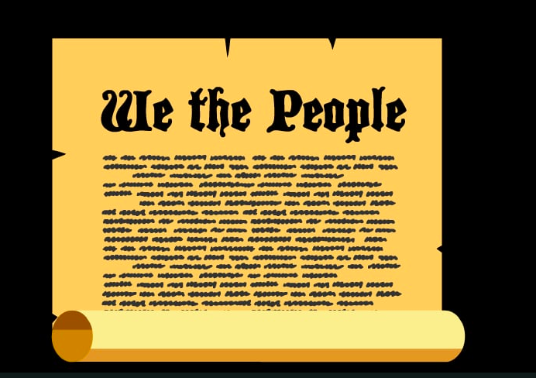
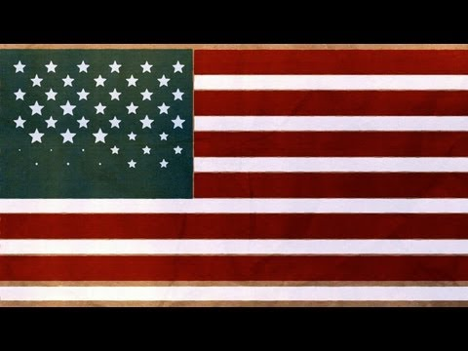
The Bill of Rights
Ted Ed Lesson

Slide 30
The Presidential Selection Process
Common Craft

Slide 31
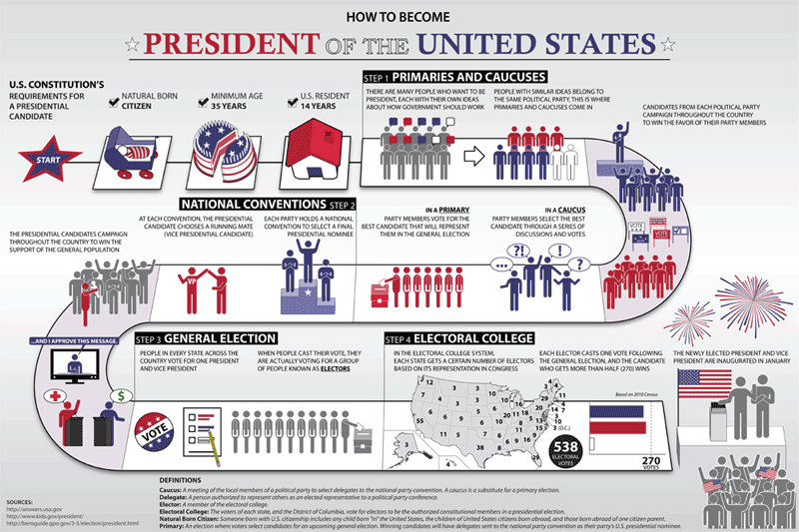

Slide 32
What’s the difference between a primary and a caucus
What is the difference between the primary/caucus election and the general election
A candidate who wins a primary gets what?
A candidate who win a state in the general election gets what?
True / False: The word nominee describes a candidate during the primary election
True / False: A party’s nominee is named at something called the national convention.
True / False: The primary election is held after the general election
True / False: The electoral college election is held after the general election.
True / False: To run for the president one must be a natural born citizen, at least 35 years of age, and have resided in the United States for 14 years.
Notes:
What’s the difference between a primary and a caucus In presidential campaigns, a caucus is a system of local gatherings where voters decide which candidate to support and select delegates for nominating conventions. A primary is a statewide voting process in which voters cast secret ballots for their preferred candidates.
What is the difference between the primary/caucus election and the general election. The goal of the primary election is for each political party to select their nominee for the general election. The goal of the general election is to decide which of the party nominees will become the President of the United States.
A candidate who wins a primary gets what? Delegates
A candidate who win a state in the general election gets what? Electors
True / False: The word nominee describes a candidate during the primary election False
True / False: A party’s nominee is named at something called the national convention. True
True / False: The primary election is held after the general election False
True / False: The electoral college election is held after the general election. True
True / False: To run for the president one must be a natural born citizen, at least 35 years of age, and have resided in the United States for 14 years. True

Slide 33
With the word Civil
Civil Rights Movement
Civil Disobedience
Civil Rights
Civil Liberties
Ending Separate but Equal and Bringing about Integration
Brown v. Board of Education
Federal Troops
Civil Rights Act of 1964
Voting Rights Act of 1968
NAACP / Martin Luther King
Nonviolent Civil Disobedience / Sit-ins / Montgomery Bus Boycott / Rosa Parks
Affirmative Action
Entitlements
Social Security
Medicare
Medicaid
The Military
Having to do with Free Speech
Slander
Liberal
Symbolic Speech
Prior Restraint
Television Coverage
Spots
Visuals
Notes:
With the word Civil
Civil Rights Movement:
Civil Disobedience: Opposing a law considered unjust by peacefully disobeying it and accepting the resultant punishment. (6)
Civil Rights: The rights found in the 14th Amendment. The rights of people to be treated without unreasonable or unconstitutional differences. (6)
Civil Liberties: The rights found in the 1st, 4th, 5ht, 6th, and 8th amendments.
Ending Separate but Equal
Brown v. Board of Education:
Federal Troops:
Civil Rights Act of 1964:
NAACP / Martin Luther King:
Nonviolent Civil Disobedience / Sit-ins / Montgomery Bus Boycott / Rosa Parks:
Affirmative Action: Programs designed to increase minority participation in some institution (businesses, schools, labor unions, or government agencies) by taking positive steps to appoint more minority-group members. (6)
Entitlements
Entitlements: A claim for government funds that cannot be changed without violating the rights of the claimant. (18)
Social Security:
Medicare:
Medicaid:
The Military:
Having to do with Free Speech
Slander:
Liberal:
Symbolic Speech: An act that conveys a political message. (5)
Prior Restraint: Censorship of a publication. (5)
Television Coverage
Spots:
Visuals:

Slide 34
Separation of Powers
Power of the Executive Branch vs. Power of the Judicial Branch vs. Power of the Legislative Branch
Federal Power vs. State Power
Different kinds of primaries
Closed:
Open:
Blanket
Government
Divided Government
Unified Government
Not in Constitution
Bureaucracy
Cabinet
Judicial Review
Direct election of Senators
Term limit on office of president
Executive Privilege
Executive Order
Right to Privacy (as found by court in Roe v. Wade)
Press Coverage
Feature stories
Routine stories
Inside stories
Notes:
Separation of Power
Power of the Executive Branch vs. Power of the Judicial branch vs. Power of the Legislative Branch
Federal Power vs. State Power:
Different Kinds of Primaries
Closed: A primary election in which voting is limited to already registered party members. (10)
Open: A primary election in which voters may choose in which party to vote as they enter the polling place. (10)
Blanket: A primary election in which each voter may vote for candidates from both parties. (10)
Divided Government: One party controls the White House and another party controls one or both houses of Congress. (13, 14)
Not in Constitution
Unified Government: The same party controls the White House and both houses of Congress. (13, 14)
Bureaucracy: A large, complex organization composed of appointed officials. (15)
Cabinet: The heads of the 15 executive branch departments of the federal government. (14)
Judicial Review: The power of courts to declare laws unconstitutional. (2, 16)
Direct election of Senators:
Term limit on office of president:
Executive Order:
Right to Privacy (as found by court in Roe v. Wade):
Press Coverage
Feature stories: Media stories about events that, though public, are not regularly covered by reporters. (12)
Routine stories: Media stories about events regularly covered by reporters. (12)
Inside stories: Media stories about events that are not usually made public. (12)

Slide 35
Policies that Affect the Budget
Monetary Policy
Fiscal Policy
With the word Tax
Progressive tax
Flat tax
Tax cut
Supply side tax cut
Tax loophole
Income tax
With the word Presidential
Presidential coattails
Presidential succession
Presidential veto
How USSC Justices are Viewed
As Judicial Active
As Judicially Restrained
As a Strict Constructionist
As a Loose Constructionist
With the word Rights
Unalienable Rights
Natural Rights
Civil Rights
Civil Rights Movement
Bill of Rights
The USSC Appointment Process
Senatorial Courtesy
Litmus Test
Confirmation
Notes:
Policies that Affect the Budget
Monetary Policy: Managing the economy by altering the supply of money and interest rates. (18)
Fiscal Policy: Managing the economy by the use of tax and spending laws. (18)
With the word Tax
Progressive Tax:
Flat tax:
Tax cut:
Supply side tax cut:
Tax loophole:
Income tax:
With the word Presidential
Presidential coattails:
Presidential succession:
Presidential veto:
How USSC Justices are Viewed
As JudicIal Active:
As Judicially Restrained:
As a Strict Constructionist:
As a Loose Constructionist:
With the word Rights
Unalienable Right: A human right based on nature or God. (2)
Natural Rights:
Civil Rights: The rights of people to be treated without unreasonable or unconstitutional differences. (6)
Civil Rights Movement:
Bill of Rights: First ten amendments to the Constitution. (2)
The USSC Appointment Process
Senatorial Courtesy:
Litmus test: An examination of the political ideology of a nominated judge. (16)
Confirmation:

Slide 36
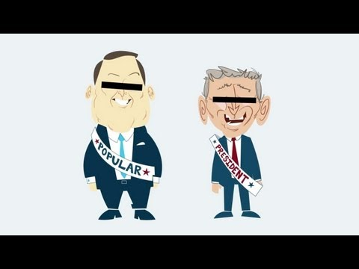
The Electoral College
Ted Ed Lesson

Slide 37
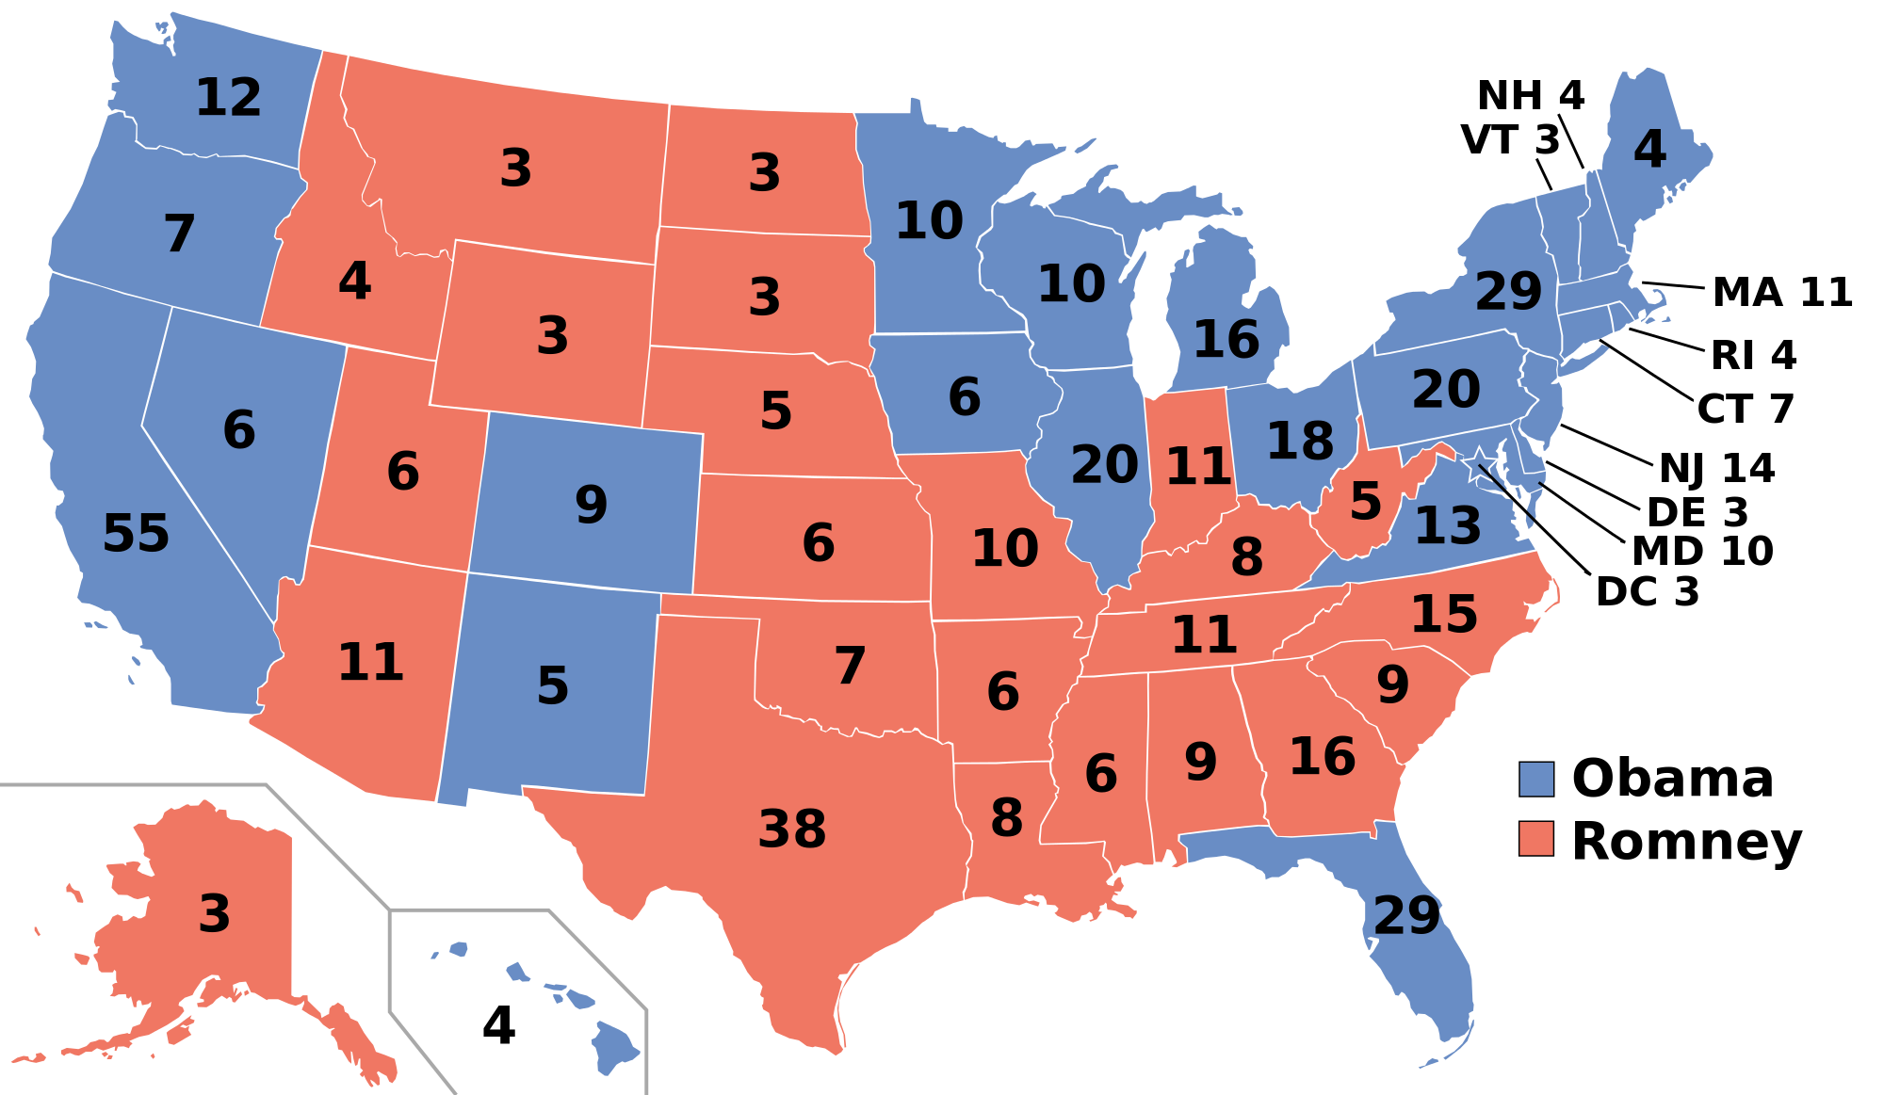

Slide 38
How does one become an elector?
Since 1964 there have been how many electors?
As of 2016, how many voting mem-
bers can be found in the House of Representatives?
As of 2016, how many voting members can be found in the Senate?
As of 2016, how many voting members from the District of Columbia can be found in the Congress?
As of 2016, how many voting members can be found in the Congress?
As of 2016, how many electors must the party nominee receive in order to be formally declared President of the United States
The electoral college follows the _____ system rather than the _____ system
True / False: A party nominee can win the general election and not become the president of the United States

Slide 39
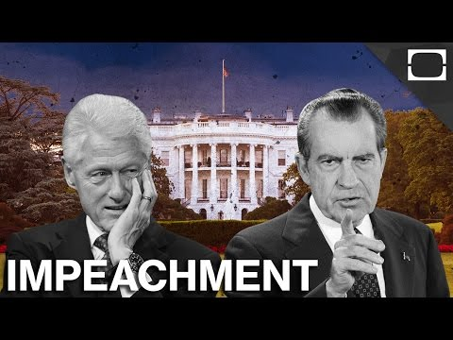
The Impeachment Process
TestTube News

Slide 41
Who has the power to impeach
Who has the power to preside over the trial following an impeachment and who serves as the jury
To impeach requires a _____vote and to convict a president at the trial following impeachment requires a _____ vote
What is the penalty for being found guilty at a trial following impeachment
How many presidents have been impeached.
How many presidents have been found guilty at the trial following an impeachment.
True / False: Richard Nixon was impeached.
True / False: Bill Clinton was impeached
True / False: A president may pardon himself in the case of impeachment.
How many presidents have been removed from office by way of the impeachment process.

Slide 42
Elections #1
Primary and Caucus Elections
National Party Convention Election
General Election
Electoral College Election
Realignment Election
Mid Term Elections
Elections #2
Presidential Elections
Congressional Elections
Gubernatorial Elections
Elections #3
Incumbent
Challenger
Elections #4
Winner Take All System
Proportional System
Elections #5
Standard Election
Realignment Election (Critical Election)
Elections #6
Public Funding
Private Funding
Notes:
Election #1
Primary and Caucus Elections: An election held to choose candidates for office. (10) / A meeting of party members to select delegates backing one or another primary candidate. (9, 10, 13)
National Party Convention Election:
General Election: An election held to choose which candidate will hold office. (10)
Electoral College Election:
Realignment Election: A realignment election (often called a critical election or political realignment) is a term from political science and political history describing a dramatic change in the political system. Usually it means the coming to power for several decades of a new coalition, replacing an old dominant coalition of the other party as in 1896 when the Republican Party (GOP) became dominant, or 1932 when the Democratic Party became dominant. More specifically, it refers to American national elections in which there are sharp changes in issues, party leaders, the regional and demographic bases of power of the two parties, and structure or rules of the political system (such as voter eligibility or financing), resulting in a new political power structure that lasts for decades.
Midterm Election: Elections held midway between presidential elections.
Election #2
Presidential Elections: Elections held to select the President (Wiki)
Congressional Elections: Elections held to select members of the House and Senate (Wiki)
Gubernatorial Elections: Elections held to select the governor of each state. (Wiki)
Election #3
Incumbent: The person already holding an elective office. (10)
Challenger: The person who wants to replace the incumbent (Wiki)
Election #4
Winner Take All System: Election system in which the candidate with the most votes gets all the delegates and/or electors
Proportional System: Proportional system in which each candidate running receives the proportion of delegates/electors corresponding to its proportion of the vote.
Standard Election: An election where the Democratic voter typically votes for the Democratic candidate and and the Republican voter typically votes for the Republican candidate. Predictable. Contract with Critical Election (aka Realignment Election)
Realignment Election (Critical Election): An election during periods of expanded suffrage and change in the economy and society that proves to be a turning point, redefining the agenda of politics and the alignment of voters within parties. Also known as a critical election
Election #5
Public Funding:
Private Funding:

Slide 43
The President's power to say no
Veto
Executive Privilege
Executive Order
Impoundment
Types of Legislatures #1
Bicameral
Unicameral
Types of Legislatures #2
Federal Legislature
State and Local Legislature
Segregation
De Jure Segregation
De Facto Segregation
Check (as in checks and balances)
How the LB checks the EX
How the LB checks the JB
How the LB checks the B
How the EB checks the LB
How the EB checks the JB
How the EB checks the B
How the JB checks the LB
How the JB checks the EB
How the JB checks the B
Money
Soft Money
Hard Money
Notes:
The President’s Power to say No
Veto: Literally, “I forbid”: It refers to the power of a president to disapprove a bill; it may be overridden by a two-thirds vote of each house of Congress. (13)
Executive Privilege:
Executive Order:
Impoundment:
Types of Legislatures #1
Bicameral: A lawmaking body made up of two chambers or parts. Congress is bicameral (13)
Unicameral: A lawmaking body made up of one chamber or part..
Types of Legislatures #2
Federal Legislature: The Congress, located in Washington D.C., and assigned to make laws. Consists of a House and a Senate
State and Local Legislature: In California, located in Sacramento, and assigned to make laws. Consists of an Assembly and a Senate
Segregation
De Jure Segregation: Racial segregation that is required by law. (6)
De Facto Segregation: Racial segregation that occurs in schools, not as a result of the law, but as a result of patterns of residential settlement. (6)
Checks
How the LB checks the EX:
How the LB checks the JB:
How the LB checks the B:
How the EB checks the LB:
How the EB checks the JB:
How the EB checks B:
How the JB checks the LB:
How the JB checks the EB:
How the JB checks the B:
Money
Soft Money: Money raised in unlimited amounts by political parties for party-building purposes. Now largely illegal except for limited contributions to state or local parties for voter registration and get-out-the-vote efforts. (wiki)
(10)
Hard Money: Political contributions given to a party, candidate, or interest group that are limited in amounts and fully disclosed. Raising such limited funds is harder than raising unlimited funds, hence the term “hard money.” (wiki)

Slide 44
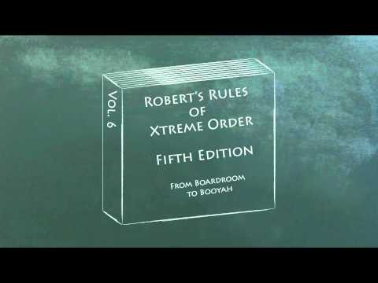
The Federal Budget Making Process
AnnimateEducate

Slide 45
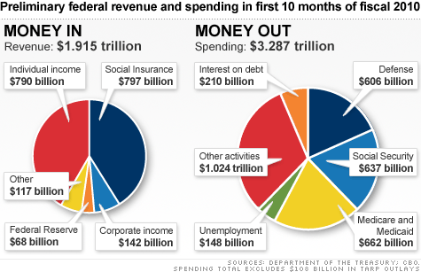

Slide 46
True / False: The total national debt is around $13 trillion
True / False: Entitlements such as Social Security or Medicare make up about 2/3rds of the federal budget.
True / False: In reality, the government can change only about one-third of federal spending in any year.
True / False: In general, conservative economists tend to support monetarism and supply side economics
True / False: The executive office in charge of forecasting economic trends is the Council of Economic Advisers.
True / False: The OMB produces the budget for the president.
The secretary of the Treasury provides the president with estimates of tax revenues.
True / False: The responsibilities of the Federal Reserve Board lie in the area of monetary rather than fiscal policy.

Slide 47
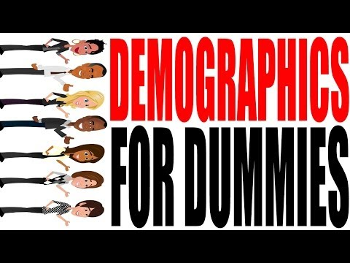
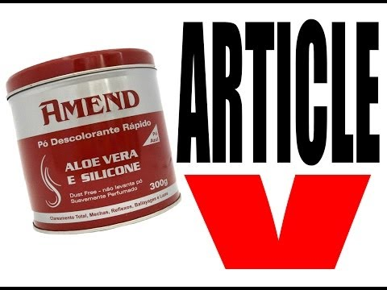
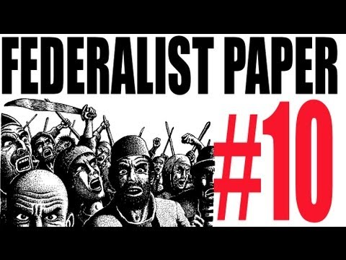
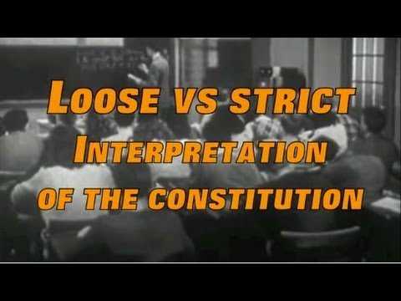
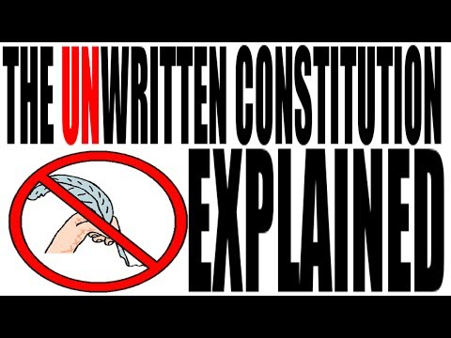
The Amendments Demographics The Amendment Process
Federalist Paper #10 Loose v. Strict Construction The Unwritten Constitution
Notes:
Keith Hughes
The Amendments
Demographics
The Amendment Process
Federalist Paper $10
Loose vs. Strict Construction
The Unwritten Constitution
-----------------
About Keith Hughe (from Wikipedia: April 2016)
Keith Jon Hughes is a Buffalo, New York teacher and media personality, best known for his YouTube channel "HipHughes History". His YouTube channel has seen millions of views since starting in 2008. Recently Hughes has been a featured historian in two television series about U.S. History, "United Stuff of America" on History and "America's Most Badass" on American Heroes Channel.
Born in the lower Hudson Valley and raised in Putnam Valley, N.Y. In 1994, Keith moved to Buffalo to attend Buffalo State College where he received his undergraduate degree in Social Studies Education. He went on to receive his master's degree in Educational Technology from the University of Buffalo in 2006.
Hughes started teaching full-time in 1999 at McKinley High School; his focus was teaching U.S. History and Advanced Placement American Government. Shortly after the September 11 attacks Hughes collaborated with his students on his first video, "Wings of Hope". The success of this project evolved into bringing in video production and media into his courses.
In the fall of 2014, Hughes started a new phase of his teaching career as a Technology Instructional Coach for the Buffalo Public School district, leaving the teaching role he had for the last 15 years. Hughes is still teaching as an adjunct professor of education at the Graduate School of Education at the University of Buffalo.
On April 20, 2008; he started his educational YouTube Channel HipHughes History, which focuses on government, politics and history. He was recognized by YouTube with an EDU Guru award in 2012.
Keith has appeared on H2's series, "United Stuff of America" and is currently on the American Heroes Channel's "America's Most Badass". In addition he has given numerous professional development seminars and speaking engagements to educators across the country; being an advocate for the teaching profession.

Slide 48
Clauses
Free Exercise Clause
Establishment Clause
Due Process Clause
Reserved Powers Clause
Equal Protection Clause
Free Speech Clause
Implied Powers (aka Necessary and Proper) Clause
Commerce Clause
Famous Written Works
Declaration of Independence
Articles of Confederation
Constitution
Federalist Papers
Bill of Rights
The Philadelphia Convention
Virginia Plan
New Jersey Plan
Great Compromise
Mandates
Funded Mandate
Unfunded Mandate
Types of Democracy
Direct
Representative
Political Ideology
Liberal
Conservative
Moderates
Notes:
Clauses
Free Exercise Clause: First Amendment requirement that law cannot prevent free exercise of religion. (5)
Establishment Clause: First Amendment ban on laws “respecting an establishment of religion.” (5)
Due Process Clause:
Reserved Powers Clause:
Equal Protection Clause:
Free Speech Clause:
Implied Powers (aka Necessary and Proper) Clause: Section of the Constitution allowing Congress to pass all laws “necessary and proper” to its duties, and which has permitted Congress to exercise powers not specifically given to it (enumerated) by the Constitution.
Commerce Clause:
Famous Written Works
Declaration of Independence:
Articles of Confederation: A weak constitution that governed America during the Revolutionary War. (2)
Constitution:
Federalist Papers:
Bill of Rights: First ten amendments to the Constitution. (2)
The Philadelphia Convention
Virginia Plan: Proposal to create a strong national government. (2)
New Jersey Plan: Proposal to create a weak national government. (2)
Great Compromise: Plan to have a popularly elected House based on state population and a state-selected Senate, with two members for each state. (2)
Mandates Terms set by the national government that states must meet whether or not they accept federal grants.
Funded Mandate: An funded mandate is a statute or regulation that requires a state or local government to perform certain actions, with money provided for fulfilling the requirements.
Unfunded Mandate: An unfunded mandate is a statute or regulation that requires a state or local government to perform certain actions, with no money provided for fulfilling the requirements. Public individuals or organizations can also be required to fulfill public mandates. (Wiki)
Types of Democracy
Direct Democracy: A government in which all or most citizens participate directly. (1)
Representative Democracy: A government in which leaders make decisions by winning a competitive struggle for the popular vote. (1)
Political Ideology
Liberal:
Conservative:
Moderates:

Slide 49
Systems of Government
Confederate System of government
Unitary System of Government
Federal System of Government
Grants in Aid
Block Grant
Categorical Grant
Culture War
Progressive View
Orthodox View
Tickets
Straight Tickets
Split Tickets
Drawing District Lines
Census
Apportionment / Reapportionment / Malapportionment
Redistricting
Gerrymandering
State Legislature
Districts
Safe District
Marginal District
Issues
Valence Issue
Position Issue
Notes:
Systems of Government
Confederate System of Government: When the state governments have more power/control than the federal government
Unitary System of Government: When the federal government has more power/control than the state governments
Federal System of Government: When the federal and state governments share some power, but also have their own powers.
Grants in Aid Money given by the national government to the states.
Block Grant: a block grant is a large sum of money granted by the national government to a regional government with only general provisions as to the way it is to be spent, in contrast to a categorical grant, which has stricter and specific provisions on the way it is to be spent. (Wiki)
Categorical Grants: Federal grants for specific purposes, such as building an airport. (3)
Culture War
Progressive View:A belief that personal freedom and solving social problems are more important than religion. (4)
Orthodox View: A belief that morality and religion ought to be of decisive importance. (4)
Tickets
Straight Ticket: Voting for candidates of the same party. (9)
Split Ticket: Voting for candidates of different parties for various offices in the same election. (9)
Drawing District Lines
Census:
Apportionment/ Reapportionment:
Malapportionment: Drawing the boundaries of legislative districts so they are unequal in population. (10)
Redistricting:
Gerrymandering: Drawing the boundaries of legislative districts in bizarre or unusual shapes to favor one party. (10)
State Legislature: The ones who draw the district boundaries every ten years (for the purpose of reapportionment and redistricting)
Districts
Safe District: House districts in which candidates elected to the House of Representatives win in not so close elections, typically by more than 55 percent of the vote
Marginal Districts: House districts in which candidates elected to the House of Representatives win in close elections, typically by less than 55 percent of the vote. (13)
Issues
Valence Issue: An issue about which the public is united and rival candidates or political parties adopt similar positions in hopes that each will be thought to best represent those widely shared beliefs. (10)
Position Issue: An issue about which the public is divided and rival candidates or political parties adopt different policy positions. (10)

Slide 50
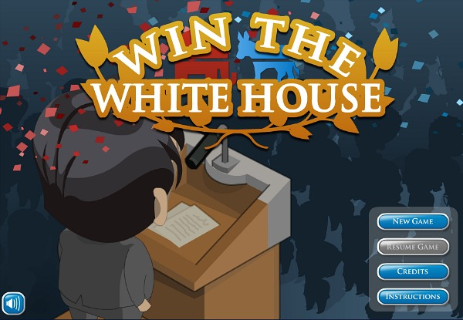
Win the White House is a game. To play the game, click on the image to the left
Win the White House
Icivics
Notes:
In Win the White House, you get to manage your very own presidential campaign by strategically raising funds, polling voters, launching media campaigns, and making personal appearances. Keep a close eye on the map as you battle over electoral votes and popular support.
--------
A Supreme Court Pioneer, Now Making Her Mark on Video Games
NY Times
March 2016
Justice Sandra Day O’Connor, who turned 86 on Saturday, has many achievements to her name, including serving as a state senator in Arizona and becoming the first woman appointed to the Supreme Court, where she served for almost a quarter-century.
Now she can add an accomplishment for the digital era: video game impresario.
Justice O’Connor is behind an animated civics education game called Win the White House, whose latest edition was recently released. The game has been played by more than 250,000 students just this month and is barnstorming its way through middle schools across the United States.
In the game — timed to this election cycle — students take on the role of imaginary presidential candidates who must learn how to compete civilly against opponents with divergent views on issues like immigration and gun control.
That Justice O’Connor would become an interactive game enthusiast may seem unexpected. Until a few years ago, she had never watched a video game — let alone played one.
“I was one of the uneducated adults,” she joked in a recent telephone interview from her home in Phoenix. Speaking of the learning objective of Win the White House, she explained, “We have to have a system that allows young people to approach problem solving from many different viewpoints.”
Justice O’Connor became involved in digital games after retiring from the Supreme Court in 2006. She started iCivics, a nonprofit civics education group, in 2009.
The group has since released 19 free online games, along with accompanying lesson plans, with the idea of making civics education less about rote learning and more about giving middle school students an animated glimpse into how different branches of government and the Constitution work. About 3.2 million students played iCivics games last year, the group said.
Justice O’Connor is getting colleagues involved in the effort as well. Justice Sonia Sotomayor joined iCivics’ governing board last November.
In a phone interview on Friday, Justice Sotomayor said she thought it was “brilliant of Justice O’Connor to realize that computer games could be a very successful way to interest kids in civics education.” Justice Sotomayor, who said she developed an early interest in law after watching the “Perry Mason” television show, said she had incorporated iCivics into her own frequent visits to schools, where she encourages students to learn how government works and to get involved in their communities.
“I thought this was really in keeping with my message to kids about how laws affect you every single day,” Justice Sotomayor said, adding that she has played the games. “They’re fun. I’ve challenged my clerks to play them to see how they do.”
The involvement of the two justices in digital educational games underscores a growing belief among educators that interactive tools may improve students’ engagement in their own learning. In January, Microsoft introduced an educational version of Minecraft, the popular game in which players use blocks to construct elaborate virtual worlds. Last fall, Google unveiled Expeditions, a virtual reality system for classroom use that takes students on simulated field trips around the world.
Teachers who have used Win the White House said the game helped their students experience and understand the complicated trade-offs that candidates often make.
Anna Nelson, assistant principal at Bronx Latin, a high school in New York City, recently divided her 12th-grade honors civics class into Democratic and Republican teams and assigned them to play the game. Along the way, her students learned the difference between conservative and liberal political beliefs, and that candidates had to stick to the platforms they had chosen, she said. They also learned to select running mates from different backgrounds to broaden their appeal with voters.
“It taught them so many things in one short simulation,” Ms. Nelson said. Now, when they come to class, they want to discuss new developments in the actual presidential primaries with her, she said.
Justice Sotomayor suggested parents play the games with their children as well. “Do you know how many adults don’t know anything about civics?” she said.
Justice O’Connor said she started iCivics out of concern that many schools had abandoned the idea of teaching students to become engaged citizens. She said she worried that students would not grow up to become good leaders, or even active voters, if they did not understand, say, the importance of an independent judiciary or their right to due process.
“A quarter of students cannot demonstrate a proficient knowledge of how our government works,” Justice O’Connor said, while “their knowledge of TV shows like ‘American Idol’ is way up there.”
She said she began to seriously investigate the idea of educational games after consulting with James Gee, a professor of literacy studies at Arizona State University and the author of a book titled “What Video Games Have to Teach Us About Learning and Literacy.”
“I explained to her that games were not about shooting people,” Professor Gee said. “They were about problem solving.”
Filament Games, a learning games company in Madison, Wis., one of whose founders is a former student of Professor Gee, designed the games for iCivics, which is based in Cambridge, Mass. Justice O’Connor’s own passions and priorities were central to the development of a number of the games — among them Supreme Decision, in which students take on the role of an imaginary Supreme Court justice who must cast the deciding vote in a case.
In one of the most popular iCivics games, called Do I Have a Right?,students run a fictional constitutional law firm, taking on clients, figuring out which rights apply to them and arguing their cases. Although the game could not have anticipated recent contentious issues like the iPhone privacy fight between Apple and the F.B.I., it covers topics that may give students insights into current events or their own experiences.
“I was struck that many students did not know their rights,” said Danny O’Sullivan, a 17-year-old high school senior in Washington. The son of one of Justice O’Connor’s former clerks, he helped test the iCivics game with students at a different local high school. “They didn’t know that if a cop stopped them and searched them without a reason, it was illegal,” he said.
The game also has playful elements. Students who collect enough points to buy a virtual coffee maker for their imaginary law firm will find that the game speeds up, in a nod to the availability of virtual caffeine.
Justice O’Connor said it was important for the games to be inclusive and nonpartisan.
Students who play Win the White House may choose avatars, male or female; blond or brunet; goateed or clean-shaven; Democratic or Republican; beige or brown. But whether players decide to support, say, gun rights or gun control, the game provides neutral explanations of each stance.
Justice O’Connor will go down in the annals of American history for being the FWOTSC — her nickname for First Woman on the Supreme Court — not to mention the swing vote in Bush v. Gore, the Supreme Court case that effectively settled the contested 2000 presidential election. But these days, she likes to say her efforts to encourage students to understand and participate in government represent her most important legacy.
When she attended a recent reunion of her former clerks, she insisted that they bring laptops so she and their children — she calls them the grandclerks — could play iCivics games together.
“Government isn’t handed down in the genes,” Justice O’Connor said. “It has to be taught through every generation.”

Slide 51
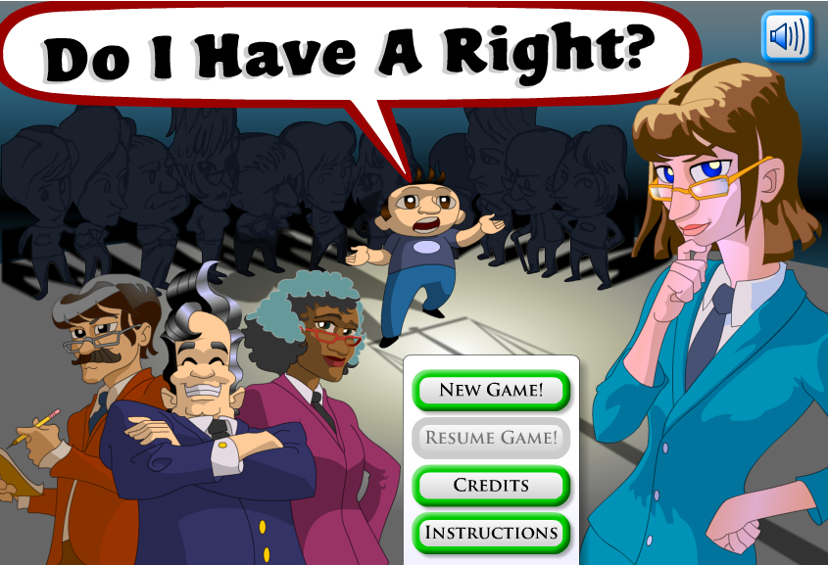
Do I Have a Right is a game. To play the game, click on the image to the left
Do I Have a Right
Icivics
Notes:
In Do I Have A Right?, you’ll run your own firm of lawyers who specialize in constitutional law.
You’ll need to decide whether potential clients “have a right,” and if so, match them with the right lawyer. The more clients you serve and the more cases you win, the faster your law firm will grow! Can you think on your feet? You're going to have to!.

Slide 52
Supreme Decision is a game. To play the game, click on the image to the left
Supreme Decision
Icivics
Notes:
Ever wondered how the Supreme Court really works? In Supreme Decision, you help cast the deciding vote. At stake is the suspension of Ben Brewer who wore his favor band t-shirt to school against dress policy. You’ll help the final Justice make up her mind and influence the outcome of the case!

Slide 53
Important Verbs
Ratify
Confirm
Nominate (appoint)
Override
Veto
Impeach
Try (following impeachment)
Grant (pardons and reprieves)
Lobby
Filibuster
Declare unconstitutional
Give (aka give the opinion of the court)
Make
Execute (carry out)
Interpret
Words with the word Journalism
Attack Journalism
Horserace Journalism
Yellow Journalism
Investigative Journalism
Words the word Budget
Annual Budget
Balanced Budget
Budget Surplus
Budget Deficit
Budget Resolution
Notes:
Ratify: Amendments and treaties
Confirm: USSC justices, Cabinet secretaries, ambassadors, federal district and federal circuit court judges,
Nominate (appoint): USSC justices, Cabinet secretaries, ambassadors, federal district and federal circuit court judges, white house chief of staff, press secretary, etc
Override: Congress
Veto: Literally, “I forbid”: It refers to the power of a president to disapprove a bill; it may be overridden by a two-thirds vote of each house of Congress. (13)
Impeach: House
Try (following impeachment): Senate
Grant (pardons and reprieves): President
Lobby: Lobbyist and interest group representatives
Filibuster: Senators. An attempt to defeat a bill in the Senate by talking indefinitely, thus preventing the Senate from taking action on the bill. (13) Using the filibuster to delay or block legislative action has a long history. The term filibuster:- from a Dutch word meaning "pirate":- became popular in the 1850s, when it was applied to efforts to hold the Senate floor in order to prevent a vote on a bill.
In the early years of Congress, representatives as well as senators could filibuster. As the House of Representatives grew in numbers, however, revisions to the House rules limited debate. In the smaller Senate, unlimited debate continued on the grounds that any senator should have the right to speak as long as necessary on any issue.
In 1841, when the Democratic minority hoped to block a bank bill promoted by Kentucky Senator Henry Clay, he threatened to change Senate rules to allow the majority to close debate. Missouri Senator Thomas Hart Benton rebuked Clay for trying to stifle the Senate's right to unlimited debate.
Three quarters of a century later, in 1917, senators adopted a rule (Rule 22), at the urging of President Woodrow Wilson, that allowed the Senate to end a debate with a two-thirds majority vote, a device known as "cloture." The new Senate rule was first put to the test in 1919, when the Senate invoked cloture to end a filibuster against the Treaty of Versailles. Even with the new cloture rule, filibusters remained an effective means to block legislation, since a two-thirds vote is difficult to obtain. Over the next five decades, the Senate occasionally tried to invoke cloture, but usually failed to gain the necessary two-thirds vote. Filibusters were particularly useful to Southern senators who sought to block civil rights legislation, including anti-lynching legislation, until cloture was invoked after a 60 day filibuster against the Civil Right Act of 1964. In 1975, the Senate reduced the number of votes required for cloture from two-thirds to three-fifths, or 60 of the current one hundred senators.
Many Americans are familiar with the filibuster conducted by Jimmy Stewart, playing Senator Jefferson Smith in Frank Capra's film Mr. Smith Goes to Washington, but there have been some famous filibusters in the real-life Senate as well.
During the 1930s, Senator Huey P. Long effectively used the filibuster against bills that he thought favored the rich over the poor. The Louisiana senator frustrated his colleagues while entertaining spectators with his recitations of Shakespeare and his reading of recipes for "pot-likkers." Long once held the Senate floor for 15 hours. The record for the longest individual speech goes to South Carolina's J. Strom Thurmond who filibustered for 24 hours and 18 minutes against the Civil Rights Act of 1957.
Declare unconstitutional: USSC
Give (aka give the opinion of the court): USSC (gives majority opinion, minority opinion, concurring opinion, dissenting opinion
Make: Congress (legislative branch)
Execute (carry out): President (executive branch)
Interpret: USSC (judicial branch)
Attack Journalism:
Horserace Journalism: News coverage that focuses on who is ahead rather than on the issues
Yellow Journalism:
Investigative Journalism:
Annual Budget: The document that says what the government plans to take in and what it plans to spend
Balanced Budget: When a government says it will take in only what it spends
Budget Surplus: When a government says it will take in more than what it spends
Budget Deficit: When a government says it will take in less than what it spends
Budget Resolution: A congressional decision that states the maximum amount of money the government should spend

Slide 54
With the word Power
Implied Power
Express Power / Enumerated Power
Formal Power / Informal Power
Elements of Political Culture
Liberty
Equality
Democracy
Civic Duty
Individual Responsibility
Powers of State and Federal Government
Enumerated: Powers given to the national government exclusively (print money, declare war, make treaties, conduct foreign affairs, and regulate commerce among the states).
Reserved: Powers given exclusively to the state's (power to issue licenses, regulate intrastate commerce).
Concurrent: Powers shared by both the national and state governments (taxes, building roads, borrowing money, having courts).
Notes:
Implied Power:
Express Power / Enumerated Power:
Formal Power / Informal Power:
Liberty:
Equality:
Democracy: The rule of the many. (1)
Civic Duty: A belief that one has an obligation to participate in civic and political affairs. (4)
Individual Responsibility:
Enumerated: Powers given to the national government alone. (2)
Reserved: Powers given to the state government alone. (2)
Concurrent: Powers shared by the national and state governments. (2)

Slide 55
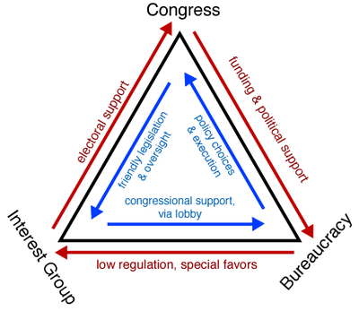
Notes:
At one time scholars described the relationship between an agency, a committee, and an interest group as an iron triangle.
For example, the Department of Veterans Affairs, the House and Senate committees on veterans' affairs, and veterans' organizations (such as the American Legion) would form a tight, mutually advantageous alliance. The department would do what the committees wanted and in return get political support and budget appropriations; the committee members would do what the veterans' groups wanted and in return get votes and campaign contributions. Iron triangles are examples of what are called client politics.
Many agencies still have important allies in Congress and the private sector, especially those bureaus that serve the needs of specific sectors of the economy or regions of the country. The Department of Agriculture works closely with farm organizations, the Department of the Interior with groups interested in obtaining low-cost irrigation or grazing rights, and the Department of Housing and Urban Development with mayors and real-estate developers.
Sometimes these allies are so strong that they can defeat a popular president. For years, President Reagan tried to abolish the Small Business Administration (SBA), arguing that its program of loans to small firms was wasteful and ridden with favoritism. But Congress, reacting to pressures from small-business groups, rallied to the SBA's defense. As a result, Reagan had to oversee an agency that he didn't want.
But iron triangles are much less common today than once was the case. Politics of late has become far more complicated. For one thing, the number and variety of interest groups have increased so much in recent years that scarcely any agency is not subject to pressures from several competing interests instead of only from one powerful interest. For another, the growth of subcommittees in Congress has meant most agencies are subject to control by many different legislative groups, often with very different concerns. Finally, the courts have made it much easier for all kinds of individuals and interests to intervene in agency affairs.
As a result, nowadays government agencies face a bewildering variety of competing groups and legislative subcommittees that constitute not a loyal group of allies, but a fiercely contentious collection of critics. The Environmental Protection Agency is caught between the demands of environmentalists and those of industry organizations, the Occupational Safety and Health Administration between the pressures of labor and those of business, and the Federal Communications Commission between the desires of broadcasters and those of cable television companies. Even the Department of Agriculture faces not a unified group of farmers, but many different farmers split into rival groups, depending on the crops they raise, the regions in which they live, and the attitudes they have toward the relative merits of farm subsidies or free markets.
Political scientist Hugh Heclo has described the typical government agency today as being embedded not in an iron triangle, but in an issue network .²⁵ These issue networks consist of people in Washington-based interest groups, on congressional staffs, in universities and think tanks, and in the mass media, who regularly debate government policy on a certain subject—say, health care or auto safety. The networks are contentious, split along political, ideological, and economic lines. When a president takes office, he often recruits key agency officials from those members of the issue network who are most sympathetic to his views.
When Jimmy Carter, a Democrat, became president, he appointed to key posts in consumer agencies people who were from that part of the consumer issue network associated with Ralph Nader. Ronald Reagan, a conservative Republican, filled these same jobs with people who were from that part of the issue network holding free-market or antiregulation views. When George Bush the elder, a more centrist Republican, took office, he filled these posts with more centrist members of the issue network. Bill Clinton brought back the consumer activists. George W. Bush reversed Clinton, and Barack Obama reversed Bush. (from text)

Slide 56
The American Political Culture
Americans believe in the things appearing below
Freedom: aka liberty (both political and economic
Equality (both political and economic)
Democracy
Civic Duty
Individual Responsibility
Americans “war” over the social issues
Americans have a mistrust of government
Americans tolerate some things; not others

Slide 57
Liberty = Ams believe everybody should be able to say and do
as they please, as long as they don’t hurt someone else
Political Equality = Ams believe everybody should have an equal vote
and chance to participate
Economic Equality = Ams believe everybody should have an equal chance
to succeed (not everyone should get the same). Equality of opportunity not equality of results
Democracy = Ams believe everybody government officials should
be held accountable
Notes:
Capitalism at the heart of the American Dream are beliefs in the rights to own private property and compete freely in OPEN MARKETS with as little government involvement as possible.

Slide 58
Civic Duty = Ams believe everybody ought to take community
affairs seriously; participate in the building of a better community (school, city, state, nation, world)
Individual Resp. = Ams believe barring some disabilities, individuals are
responsible for their own actions and well being

Slide 59
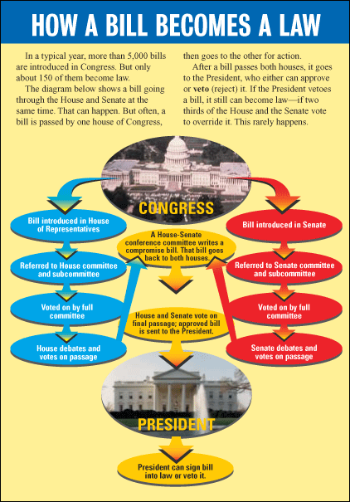

Slide 60
Theories of Government
Elite Theory
Pluralistic Theory
Bureaucratic Theory
Class (Marxist) Theory
With the word Opinion
Majority Opinion
Minority Opinion
Concurring Opinion
Dissenting Opinion
Public Opinion
Public Opinion Poll
The Bill Making Process
Bill
Committee
Rules Committee, (open, closed, restrictive rule)
Appropriations, House Ways and Means Committee
Discharge Petition
Floor
Filibuster / Cloture
Pork
Logrolling
Earmark
Roll Call vote
Quorum
Veto
Veto Override
Notes:
Elite Theory: View that the government is dominated by a few top leaders, most of whom are outside government.
Pluralistic Theory: The belief that competition among all affected interests shapes public policy.
Bureaucratic Theory: View that the government is dominated by appointed officials.
Class (Marxist) Theory: View that the government is dominated by capitalists.
Majority Opinion:
Minority Opinion:
Concurring Opinion: A signed opinion in which one or more members agree with the majority view but for different reasons. (16)
Dissenting Opinion: A signed opinion in which one or more justices disagree with the majority view. (16)
Public Opinion: How people think or feel about particular things. (7)
Public Opinion Poll:
Bill:
Committee:
Rules Committee (open, closed, restrictive rule): An order from the House Rules Committee that permits a bill to be amended on the floor. (13) ;
An order from the House Rules Committee that sets a time limit on debate; forbids a bill from being amended on the floor. (13) ; An order from the House Rules Committee that permits certain kinds of amendments but not others to be made into a bill on the floor. (13)
Appropriations: House Ways and Means Committee:
Discharge Petition: A device by which any member of the House, after a committee has had the bill for 30 days, may petition to have it brought to the floor. (13)
Filibuster / Cloture: An attempt to defeat a bill in the Senate by talking indefinitely, thus preventing the Senate from taking action on the bill. (13) / A rule used by the Senate to end or limit debate. (13)
Pork:
Logrolling: A legislator supports a proposal favored by another in return for support of his or hers. (17)
Earmarks: “Hidden” congressional provisions that direct the federal government to fund specific projects or that exempt specified persons or groups from paying specific federal taxes or fees. A provision in a law that provides a direct benefit to a client without the benefit having been reviewed on the merits by all of Congress. (11, 13)
Roll Call vote: A congressional voting procedure that consists of members answering “yea” or “nay” to their names. (13)
Quorum: The minimum number of members who must be present for business to be conducted in Congress. (13)
Veto: Literally, “I forbid”: It refers to the power of a president to disapprove a bill; it may be overridden by a two-thirds vote of each house of Congress. (13)
Veto Override:

Slide 62
Congressional Redistricting #2

Slide 64
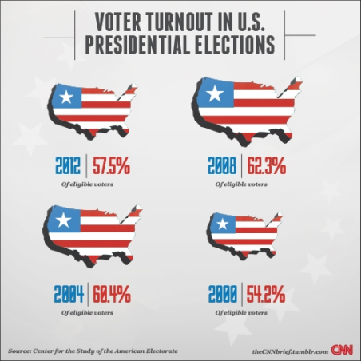

Slide 65
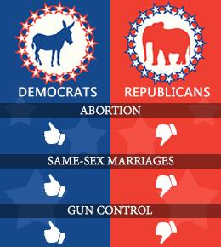

Slide 66
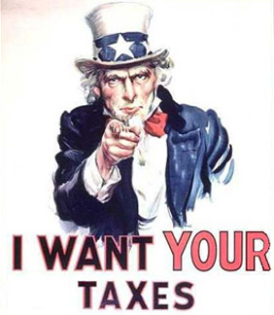

Slide 67
Free Response Questions
A number of factors enable presidents to exert influence over Congress in the area of domestic policy.
However, presidents are also limited in their influence over domestic policymaking in Congress.
The Constitution grants the president certain enumerated powers. Describe two of these formal powers that enable the president to exert influence over domestic policy.
Choose two of the following. Define each term and explain how each limits the president’s ability to influence domestic policymaking in Congress.
mandatory spending
party polarization
lame-duck period

Slide 68
Free Response Questions
The public policy process is complex. The formation, enactment, and implementation of public policy involve many government institutions.
Explain the importance of each of the following in the formation of the policy agenda.
Media
Elections
Describe the roles of each of the following in the enactment of public policy.
Congressional committees
Executive orders
Explain the importance of each of the following in the implementation of public policy.
Bureaucratic discretion
Issue networks OR iron triangles

Slide 69
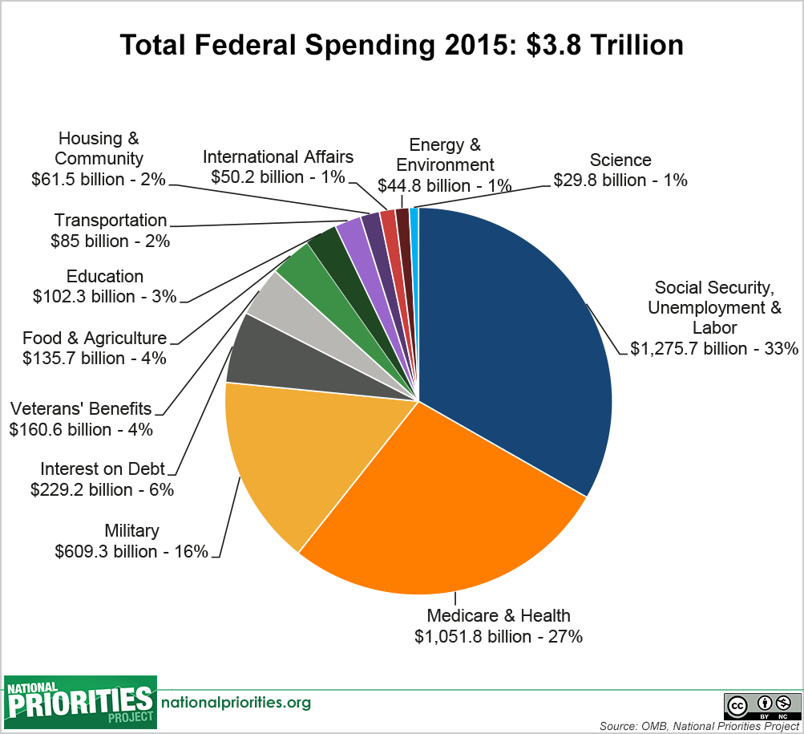
The Budget Deficit v. the National Debt

Slide 70
Devolution v. Evolution
Block grants v. categorical grants
Judicial activism v. judicial restraint
Narrow v. broad interpretation of necessary and proper cause
Narrow v. broad interpretation of the tenth amendment
Funded mandates v. unfunded mandates
Roll back of mandates v. more mandates
Raising taxes v. lowering taxes

Slide 71
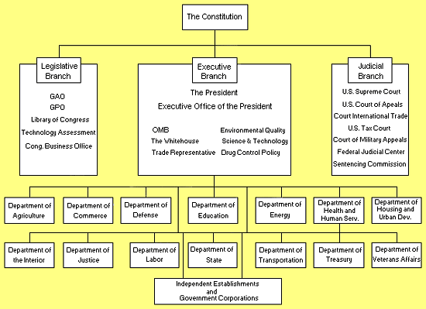
The Office of the President
The President
White House Office
(Chief of Staff, Assistant to the President)
Executive Office of the President
(Office of Management and the Budget
Notes:
The Bureaucracy
The federal bureaucracy is huge: roughly 2.6 million employees, plus many freelance contractors. Everybody in the bureaucracy works to administer the law. For the most part, the executive branch manages the federal bureaucracy. Although the executive branch controls the majority of the federal bureaucracy, the legislative and judiciary branches also have some influence. Congress, for example, controls the Library of Congress, the Congressional Research Service, and the Government Accountability Office, among other bureaucracies. Through its power of oversight, Congress also monitors the federal bureaucracy to make sure that it acts properly. The courts sometimes get involved in the bureaucracy when issues of law and constitutionality arise, such as when a civil service regulation is violated or if an agency oversteps its jurisdiction.
There are five types of organizations in the federal bureaucracy:
1. Cabinet departments
2. Independent executive agencies
3. Independent regulatory agencies
4. Government corporations
5. Presidential commissions
Bureaucratic Growth
The federal bureaucracy was small throughout much of American history. But the Great Depression, World War II, the Cold War, and President Lyndon Johnson’s Great Society programs greatly expanded the role of the federal government. George W. Bush’s War on Terror has also expanded and redefined the role of the federal government and has necessitated the creation of new organizations, such as the Department of Homeland Security.
Cabinet Departments
The executive office consists of fifteen departments. Each department is headed by a secretary.
Treasury
Interior
Justice
Agriculture
Commerce
Labor
Defense
Housing and Urban Development
Transportation
Energy
Health and Human Services
Education
Veterans’ Affairs
The president must oversee the executive bureaucracy, which includes what are known as line organizations, or the federal agencies that report directly to the president. The fifteen cabinet departments are line organizations. Political scientists sometimes refer to modern presidents as managerial presidents because they spend so much time overseeing and managing the bureaucracy.
Independent Executive Agencies
Independent executive agencies are line organizations that do not fall under the control of any one department. Presidents often like new agencies to be independent so that they have more direct control over them. Congress decides how to fit new independent executive agencies within the existing bureaucracy.
Very Important Agencies
The government needs money to function, so generating revenue is crucial. A number of different federal agencies are revenue agencies: They raise money by collecting taxes and fees. The most notorious revenue agency is the Internal Revenue Service, but it is not the only one. The Department of the Interior, for example, collects fees from people who use national parks.

Slide 72
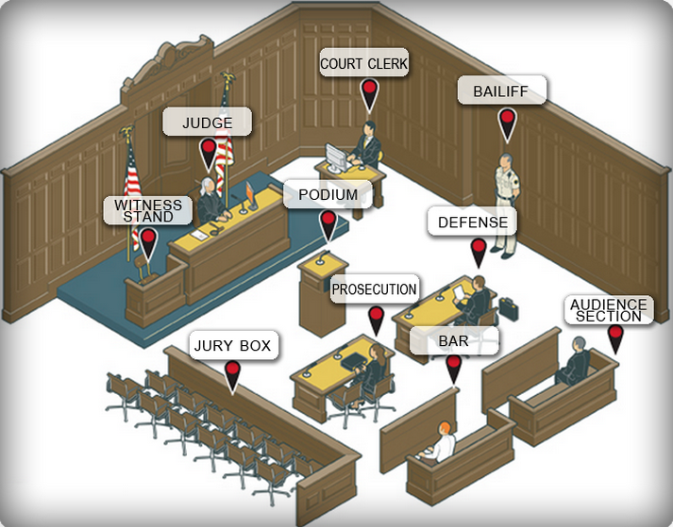
Typical
Trial Court

Slide 73
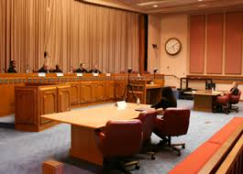
Typical
Appellate Court
Notes:
Jurisdiction
The Supreme Court hears three types of cases:
2/3 are cases appealed from lower federal courts.
1/3 are cases appealed from state supreme courts.
Rarely, they hear cases that have not been previously heard by a lower court, such as between one state's government and another.
Article III, Section II of the Constitution establishes the jurisdiction (legal ability to hear a case) of the Supreme Court.
The Court has original jurisdiction (a case is tried before the Court) over certain cases, e.g., suits
Suits between two or more states
Cases involving ambassadors and other public ministers.
The Court has appellate jurisdiction (the Court can hear the case on appeal) on almost any other case that involves a point of constitutional and/or federal law. Some examples include cases to which the United States is a party, cases involving Treaties, and cases involving ships on the high seas and navigable waterways (admiralty cases).
Cases
When exercising its appellate jurisdiction, the Court, with a few exceptions, does not have to hear a case. The Certiorari Act of 1925 gives the Court the discretion to decide whether or not to do so. In a petition for a writ of certiorari, a party asks the Court to review its case. Four of nine justices must agree into for cert to be granted. The Supreme Court agrees to hear about 100-150 of the more than 7,000 cases that it is asked to review each year.

Slide 74
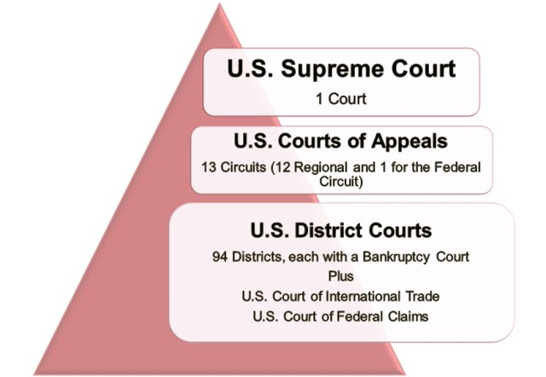

Slide 75
How Our Political Beliefs Differ
Religion (Jews more L than other religions; regular worship servers more likely C than non regular worship servers.)
Gender (F are more D than M, especially younger F)
Occupation (Unskilled more D than affluent white collar;
Race (Blacks OVERWHELMINGLY more D than white)
Economic status (Wealthy more C than non wealthy)
Region (Coast people more L than those living inland: city dwellers more L than rural dwellers)
Social class (Elite’s more likely to have ideology than masses)
Age (Younger more D than older)
Political Party (Dem’s more likely L than Rep’s)

Slide 76
Why we Don’t Vote
Not just apathy. Also because
Inconvenience: For many, getting to the polling place on election day is very difficult: Many people have to work, and some have trouble getting to their precinct.
Registration: All voters must register ahead of the election (sometimes a month or more in advance); the registration process can be confusing and at times difficult to follow.
Similarity of the parties: Some citizens believe the parties are very similar, so voting will not make a difference

Slide 77
Alienation: People do not vote because they feel that the government does not care about them or listen to their concerns.
Frequency of elections: (aka Ballot Fatigue). Americans hold elections more frequently than most other democracies; voters find it difficult to vote on so many different days.
Lack of competitiveness: Many races in the United States are very lopsided, so voters are likely to stay home, thinking the outcome is a foregone conclusion.
Ballot Fatigue
Notes:
Age and Education
Failure to Register
Competitiveness of Candidates: overall, people are more likely to vote in hotly contested elections

Slide 78
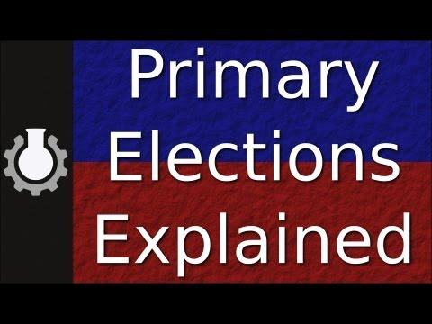

Slide 79
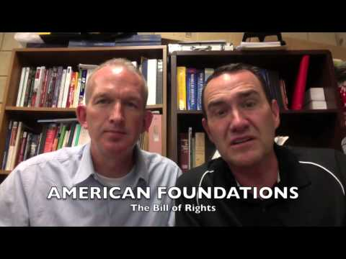
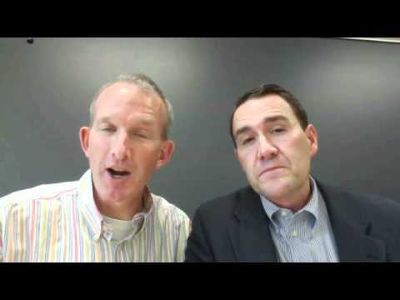
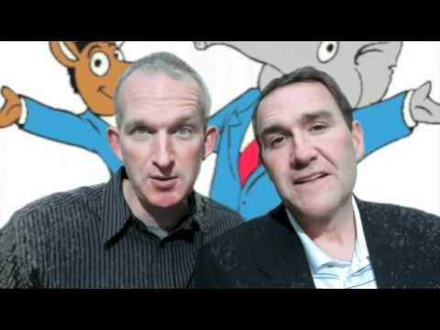
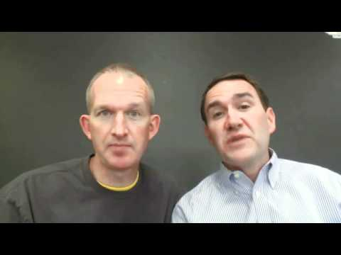
Notes:
LtR
Bill of Rights . . . Critical Elections . . . Pluralism
Two party system . . . Labels (Conservative and Liberal) . . . Litigation

Slide 80
And Don’t Forget
Joint Chiefs of Staff
National Security Council
State Department
Federal Reserve Board
Federal Communication Commission
Congressional Budget Office
General Accounting Office
Federal Election Commission
White House Office
Cabinet
NASA (independent agencies
Electoral College
National Party Convention (aka (Nominating Convention)
Primaries and caucuses
Iron Triangle
District Courts
Courts of Appeal
Civil Service
Issue Networks
Unions
Adversarial Press
National Media
Internet
Popular Press
Council of Economic Advisors
Partisan/Non Partisan
Revolving door
Notes:
Adversarial Press: The tendency of the national media to be suspicious of officials and eager to reveal unflattering stories about them.
Australian ballot: A secret ballot printed by the state
Bipartisan Campaign Reform Act (BCRA): Largely banned party soft money, restored a long-standing prohibition on corporations and labor unions for using general treasury funds for electoral purposes, and narrowed the definition of issue advocacy.
Cabinet : An advisory group selected by the president to aid in making decisions. The cabinet includes the heads of fifteen executive departments and others named by the president
Caucus : A meeting of local party members to choose party officials or candidates for public office and to decide the platform.
Civil Service: A system of hiring and promotion based on the merit principle and the desire to create a nonpartisan government service.
Closed primary : Primary election in which only persons registered in the party holding the primary may vote.
Coattail effect : The boost that candidates may get in an election because of the popularity of candidates above them on the ballot, especially the president.
Concurring opinion: An opinion that agrees with the majority in a Supreme Court ruling but differs on the reasoning.
Congressional Budget Office : An agency of Congress that analyzes presidential budget recommendations and estimates the costs of proposed legislations
Conservatism: A belief that limited government insures order competitive markets and personal opportunity.
Cooperative federalism: Stresses federalism as a system of intergovernmental relations in delivering governmental goods and services to the people and calls for cooperation among various levels of government.
Council of Economic Advisor: Agency within the Executive Office of the President that advises the President of the United States on economic policy. The CEA provides much of the objective empirical research for the White House and prepares the annual Economic Report of the President.
Courts of Appeal: A court of appeals decides appeals from the district courts within its federal judicial circuit, and in some instances from other designated federal courts and administrative agencies. The United States courts of appeals are considered among the most powerful and influential courts in the United States.
Crossover voting: Voting by member of one party for a candidate of another party.
Delegate Model: The delegate model of representation is a model of a representative democracy. In this model, constituents elect their representatives as delegates for their constituency. These delegates act only as a mouthpiece for the wishes of their constituency, and have no autonomy from the constituency.
Demographics: The study of the characteristics of populations.
Devolution revolution: The effort to slow the growth of the federal government by returning many functions to the states.
Direct primary: Election in which voters choose party nominees.
Dissenting opinion: An opinion disagreeing with a majority in a Supreme Court ruling.
District Courts:
Dual federalism (layer cake federalism): Views the Constitution as giving a limited list of powers—primarily foreign policy and national defense—to the national government, leaving the rest to the sovereign states. Each level of government is dominant within its own sphere. The Supreme Court serves as the umpire between the national government and the states in disputes over which level of government has responsibility for a particular activity.
Electoral College: The institution that elects the President and Vice President of the United States every four years. Citizens of the United States do not directly elect the president or the vice president; instead, these voters directly elect designated intermediaries called "electors," who almost always have pledged to vote for particular presidential and vice presidential candidates (though unpledged electors are possible) and who are themselves selected according to the particular laws of each state. Electors are apportioned to each of the 50 states as well as to the District of Columbia (also known as Washington, D.C.). The number of electors in each state is equal to the number of members of Congress to which the state is entitled, while the Twenty-third Amendment grants the District of Columbia the same number of electors as the least populous state, currently three. Therefore, in total, there are currently 538 electors, corresponding to the 435 members of the House of Representatives and 100 senators, plus the three additional electors from the District of Columbia.
Engle v. Vitale: a precedent setting US Supreme Court case that ruled it is unconstitutional for state officials to compose an official school prayer and encourage its recitation in public schools.
Environmental Protection Agency: An agency of the U.S. federal government which was created for the purpose of protecting human health and the environment by writing and enforcing regulations based on laws passed by Congress.
Executive agreement: A formal agreement between the U.S.president and the leaders of other nations that does not require Senate approval.
Faction: A term the founders used to refer to political parties and special interests or interest groups.
Federal Communication Commission: An independent agency of the United States government that regulates interstate communications by radio, television, wire, satellite, and cable
Federal Election Commission (FEC): A commission created by the 1974 amendments to the Federal Election Campaign Act to administer election reform laws. It consists of six commissioners appointed by president and confirmed by the Senate. Its duties include overseeing disclosure of campaign finance information and public funding of presidential elections, and enforcing contribution limits.
Federal Reserve Board: charged with overseeing the Federal Reserve Banks and with helping implement monetary policy of the United States. Governors are appointed by the President of the United States and confirmed by the Senate for staggered 14-year terms
Free rider :An individual who does not to join a group representing his or her interests yet receives the benefit of the group’s influence.
General Accounting Office : An independent, nonpartisan agency that works for Congress. Often called the "congressional watchdog," GAO investigates how the federal government spends taxpayer dollars.
Grassroots mobilization (aka lobbying) : An approach that separates itself from direct lobbying through the act of asking the general public to contact legislators and government officials concerning the issue at hand, as opposed to conveying the message to the legislators directly.
Green party :A minor party dedicated to the environment, social justice, nonviolence, and the foreign policy of nonintervention. Ralph Nader ran as the Green party’s nominee in 2000.
Hazelwood v. Kuhlmeier: The precedent setting USSC case in which the court ruled that the school paper belongs to the school, not the students, and that therefore the school can censure the paper; that students do not have a first amendment free press right when it comes to the school paper.
Honeymoon :Period at the beginning of the new president’s term during which the president enjoys generally positive relations with the press and Congress, usually lasting about six months.
Honeymoon Period: at the beginning of the new president’s term during which the president enjoys generally positive relations with the press and Congress, usually lasting about six months.
Independent expenditure :The Supreme Court has ruled that individuals, groups, and parties can spend unlimited amounts in campaigns for or against candidates as long as they operate independently from the candidates. When an individual, group, or party does so, they are making an independent expenditure.
Independent expenditures :The Supreme Court has ruled that individuals, groups, and parties can spend unlimited amounts in campaigns for or against candidates as long as they operate independently from the candidates. When an individual, group, or party does so, they are making an independent expenditure.
Joint Chiefs of Staff : a body of senior uniformed leaders in the US Department of Defense who advise the Secretary of Defense, the Homeland Security Council, the National Security Council and the President of the United States on military matters. The composition of the Joint Chiefs of Staff consists of the Chairman of the Joint Chiefs of Staff (CJCS), Vice Chairman of the Joint Chiefs of Staff (VCJCS), and the Military Service Chiefs from the Army, Marine Corps, Navy, Air Force, and the Chief of the National Guard Bureau, all appointed by the President following Senate confirmation.
Keynesian economics :Theory based on the principles of John Maynard Keynes, stating that government spending should increase during business slumps and the curve during booms.
Laissez-faire economics :Theory that opposes governmental interference in economic affairs beyond what is necessary to protect life and property.
Liberalism :A belief that government can and should achieve justice and equality of opportunity.
Libertarian party :A minor party that believes in extremely limited government. Libertarians call for a free market system, expanded individual liberties such as drug legalization, and a foreign policy of nonintervention, free trade, and open immigration.
Libertarianism :An ideology that cherishes individual liberty and insists on minimal government, promoting a free market economy, a non interventionist foreign policy, and an absence of regulation in moral, economic, and social life.
Litigation: is the term used to describe proceedings initiated between two opposing parties to enforce or defend a legal right. Litigation is typically settled by agreement between the parties, but may also be heard and decided by a jury or judge in court.
Lobbying :Engaging in activities aimed at influencing public officials, especially legislators, and the policies they enact.
Lobbyist : A person who is employed by and acts for an organized interest group or corporation to try to influence policy decisions and positions in the executive and legislative branches.
Merit system: A system of public employment in which selection and promotion depend on demonstrated performance rather than political patronage.
Minor party : A small political party that rises and falls with a charismatic candidate or, if composed of ideologies on the right or left, usually persists over time; also called a third party.
Name recognition: Incumbents have an advantage over challengers in election campaigns because voters are more familiar with them, and incumbents are more recognizable.
NASA: is an independent agency of the U Federal Government responsible for the civilian space program as well as aeronautics and aerospace research. Headed by an administrator who is appointed by the president and confirmed by the Senate
National Media :The country’s the main means of mass communication (especially television, radio, newspapers, and the Internet) regarded collectively.
National party convention :A national meeting of delegates elected in primaries, caucuses, or state conventions who assemble once every four years to nominate candidates for president and vice president, ratify the party platform, elect officers, and adopt rules.
National Security Council: Advises and assists the president on national security and foreign policies. Chaired by the President. Its members are the Vice President, the Secretary of State, the Secretary of Defense, the National Security Advisor, and the Secretary of Treasury.
Nonpartisan election :A local or judicial election in which candidates are not selected or endorsed by political parties and party affiliation is not listed on ballots.
Nonpartisan election :A local or judicial election in which candidates are not selected or endorsed by political parties and party affiliation is not listed on ballots.
Open primary :Primary election in which any voter, regardless of party, may vote.
Opinion of the Court :An explanation of the decision of the Supreme Court or any other appellate court.
Party convention :A meeting of party delegates to vote on matters of policy and in some cases to select party candidates for public office.
Party convention :A meeting of party delegates to vote on matters of policy and in some cases to select party candidates for public office.
Party identification :An informal and subjective affiliation with a political party that most people acquire in childhood.
Party identification :An informal and subjective affiliation with a political party that most people acquire in childhood.
Party registration :The act of declaring party affiliation; required by some states when one registers to vote.
Patronage :The dispensing of government jobs to persons who belong to the winning political party.
Plea bargain :Agreement between a prosecutor and a defendant that the defendant will plead guilty to a lesser offense to avoid having to stand trial for a more serious offense.
Pluralism :A theory of government that holds that open, multiple, and competing groups can check the asserted power by any one group.
Political action committee (PAC) :The political arm of an interest group that is legally entitled to raise funds on a voluntary basis from members, stockholders, or employees to contribute funds to candidates or political parties.
Political party :An organization that seeks political power by electing people to office so that its positions and philosophy become public policy.
Precedent :A decision made by a higher court such as a circuit court of appeals or the Supreme Court that is binding on all other federal courts.
Primary election :Elections in which voters determine party nominees.
Reform party :A minor party founded by Ross Perot in 1995. It focuses on national government reform, fiscal responsibility, and political accountability. It has recently struggled with internal strife and criticism that it lacks an identity.
Revolving door :Employment cycle in which individuals who work for governmental agencies that regulate interests eventually end up working for interest groups or businesses with the same policy concern.
Reynolds v. United States: The precedent setting US Supreme Court case in which the court ruled the polygamy is not protected by the first amendment’s free exercise clause.
Rider :A provision attached to a bill :to which it may or may not be related :in order to secure its passage or defeat.
Seniority rule :A legislative practice that assigns the chair of the committee or subcommittee to the member of the majority party with the longest continuous service on the committee.
Sequester
Schenck v. US: The precedent setting US Supreme Court case in which the court ruled that speech which poses a clear and present danger can be punished
Socialism: An economic and governmental system based on public ownership of the means of production and exchange.
Spoils system :A system of public employment based on rewarding party loyalists and friends.
State Department
Suffrage :The right to vote.
Tinker v. Des Moines: A precedent setting USSC case in which the court ruled that schools may only block speech that substantially disrupts the learning environment, not all speech. by the United States Supreme Court that defined the constitutional rights of students in U.S.public schools.
Trustee Model: The trustee model of representation is a model for how we should understand the role of representatives, and is frequently contrasted with the delegate model of representation. Constituents elect their representatives as 'trustees' (or 'entrust' them) for their constituency.
Turnout: The proportion of the voting age public that votes, sometimes defined as the number of registered voters that vote.
Unions (as in labor union): An organized association of workers, often in a trade or profession, formed to protect and further their rights and interests.
Wall of Separation: Thomas Jefferson’s view that Church and State should be kept separate, though the phrase can not be found in either the Declaration of Independence or the Constitution
White House Office: The White House Office is headed by the Chief of Staff, who is also the head of the Executive Office. The staff of the various offices are based in the West Wing and East Wing of the White House. It is made up of personal assistants to the president with offices in the White House. These aides are appointed but do not require Senate confirmation for appointment. They can be removed at the discretion of the president (Examples: National Security Adviser, special consultant to the president)

Slide 81
Civil Rights v. Civil Liberties
Rights found in 14th
Dred Scot
Plessy v. Ferguson
Brown v. Board of Education
Roe v. Wade
Liberties found in 1, 4, 5, 6, 8
US v. Reynolds
Schenck v. US
Tinker v. Des Moines
Hazelwood v. Kuhlmeier
Mapp v. Ohio
Miranda v. Arizona
Gideon v. Wainright
Notes:
Civil rights: Protection against a government that seeks to discriminate. The basic right to be free from unequal treatment based on (race, gender, disability, etc.) in settings such as employment and housing.
Civil liberties: Basic guaranteed freedoms (speech, press, assembly, etc)
Civil liberties include:
The right to free speech
The right to be free from unreasonable searches of your home
The right to a fair court trial
The right to an attorney
The right not to testify against yourself in a court of law
The right to vote
1st Amendment: Freedom of speech, press, petition, assembly and the right to exercise your religion freely and to be free of a government that seeks to establish a religion
4th Amendment: Protection against unreasonable search and seizure
5th Amendment: Right not to testify against yourself in a criminal case (protection against self incrimination
6th Amendment: Right to an attorney in a criminal case
8th Amendment: Protection against cruel and unusual punishment
14th: Contains the equal protection clause and the due process clause.
No state shall deny to any person the right to equal protection
No state shall deny to any person the right to life liberty and property without due process of law.
Amendments 4, 5, 6, and 8 contain the rights of those accused of a crime.
Gideon v. Wainwright: The precedent setting USSC case in which the court ruled that the government must provide counsel in criminal cases to represent defendants who are unable to afford to pay their own attorneys. Hence the creation of the public defender’s office.
The Civil Rights Movement of the 1960’s: Alll about the 14th amendment and discrimination. Think Martin Luther King, bus boycotts, school integration, etc.

Slide 82
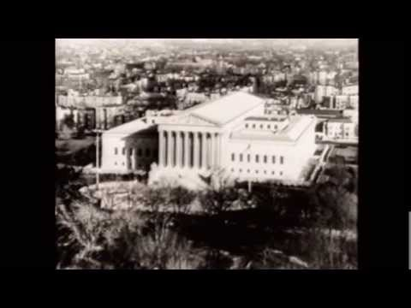
Gideon v. Wainwright
Arnold & Porter LLP

Slide 83
Tinker v. Des Moines
Mapp v. Ohio Korematsu vs. US Miranda vs. Arizona
Notes:
Annenberg Institute for Civic Engagement
Tinker v. Des Moines: The Court ruled that the First Amendment applied to public schools, and school officials could not censor student speech unless it substantially disrupted the educational process. Because wearing a black armband was not disruptive, the Court held that the First Amendment protected the right of students to wear a black armband
Mapp v. Ohio: 4th amendment search and seizure clause; established exclusionary rule: the rule that holds that evidence collected or analyzed in violation of the defendant's constitutional rights is inadmissible for a criminal prosecution in a court of law.
Korematsu v. US: Ruled that Japanese could be interned
Miranda v. Arizona: 5th amendment due process clause; ruled that accused must have his Miranda right read prior to interrogation.

Slide 85
Selective Incorporation
My Citizen U
Notes:
Selective Incorporation
Terms: A
Ideas: B
-------------
For many years after the Constitution was signed and the Bill of Rights was added to it as amendments, the liberties these documents stated applied only to the federal government. The Supreme Court made this clear in a case decided in 1833.⁴ Except for Article I which, among other things, banned ex post facto laws and guaranteed the right of habeas corpus, the Constitution was silent on what the states could not do to their residents.
This began to change after the Civil War when new amendments were ratified in order to ban slavery and protect newly freed slaves. The Fourteenth Amendment, ratified in 1868, was the most important addition. It said that no state shall “deprive any person of life, liberty, or property without due process of law ” (a phrase now known as the “due process clause”) and that no state shall “deny to any person within its jurisdiction the equal protection of the laws ” (a phrase now known as the “equal protection clause”).
Beginning in 1897, the Supreme Court started to use these two phrases as a way of applying certain rights to state governments. It first said that no state could take private property without paying just compensation, and then in 1925 held, in the Gitlow case, that the federal guarantees of free speech and free press also applied to the states. In 1937, it went much further and said in Palko v. Connecticut that certain rights should be applied to the states because, in the Court's words, they “represented the very essence of a scheme of ordered liberty” and were “principles of justice so rooted in the traditions and conscience of our people as to be ranked fundamental.”⁵
The Supreme Court began the process of selective incorporation by which some, but not all, federal rights also applied to the states. But which rights are so “fundamental” that they ought to govern the states? There is no entirely clear answer to this question, but in general the entire Bill of Rights is now applied to the states except for the following:
• The right not to have soldiers forcibly quartered in private homes (Third Amendment)
• The right to be indicted by a grand jury before being tried for a serious crime (Fifth Amendment)
• The right to a jury trial in civil cases (Seventh Amendment)
• The ban on excessive bail and fines (Eighth Amendment)
The Second Amendment that protects “the right of the people to keep and bear arms” may or may not apply to the states. In 2008, the Supreme Court in District of Columbia v. Heller held for the first time that this amendment did not allow the federal government to ban the private possession of firearms. But the case arose in the District of Columbia, which is governed by federal law. The decision raised two questions: First, will this ban be incorporated so that it also applies to state governments? In 2010, the Supreme Court said in McDonald v. Chicago that the decision in the Heller case also applied to the states.⁶ Second, will it still be possible to regulate gun purchases and gun use even if the government cannot ban guns? Based on other court cases, the answer appears to be yes. (from the text)

Slide 86
The first ten amendments to the US Constitution are most commonly known as the ______
True / False: In the first amendment, one can find two “clauses” pertaining to religion They are commonly referred to as the ______ clause and the ______ clause
True / False: A person treating the U.S. flag contemptuously is protected by the right to exercise free speech.
True / False: In the Gideon case, the USSC established something called the exclusionary rule
True / False:The Bill of Rights has come to apply to the states through the interpretation of the Fourteenth Amendment.
True / False: Selective incorporation is the term that best describes the manner in which the Supreme Court has applied the Bill of Rights to the states?
True / False:The Fourth Amendment grants individuals freedom from unreasonable searches and seizures.
Notes:
The first ten amendments to the US Constitution are most commonly known as the Bill of Rights
True / False: In the first amendment, one can find two “clauses” pertaining to religion They are commonly referred to as the Free Exercise clause and the Establishment clause
True / False: A person treating the U.S. flag contemptuously is protected by the right to exercise free speech. True
True / False: In the Gideon case, the USSC established something called the exclusionary rule True
True / False:The Bill of Rights has come to apply to the states through the interpretation of the Fourteenth Amendment. True
True / False:Selective incorporation is the term that best describes the manner in which the Supreme Court has applied the Bill of Rights to the states? True
True / False:The Fourth Amendment grants individuals freedom from unreasonable searches and seizures. True

Slide 87
Free Exercise v. Establishment Clause
Free Exercise (of religion) Clause
Practice one’s religion without government interference
US v. Reynolds (no polygamy)
Vaccination?
Smoking of peyote?
Sacrificing of animals.
Establishment Clause(
Government may neither favor nor oppose one religion over another)
Engle v.Vitale
Moment of silence
Pledge
Notes:
Lemon Test?

